Slide 1

Plumbing Studies
Level 2 Diploma

Slide 2
Course Summary
Full time course (1 year), City & Guilds qualification which builds on the basic knowledge and skills learnt at Level 1. This course offers Plumbing at an intermediate level, learning about more complex plumbing systems and installations.
Course entry requirements:
GCSE Maths and English Language at grade 4 or above
or
Functional skills level 2 in English & Maths)
or
Progression from Level 1 Plumbing
or
Prior experience in the construction industry

Slide 3
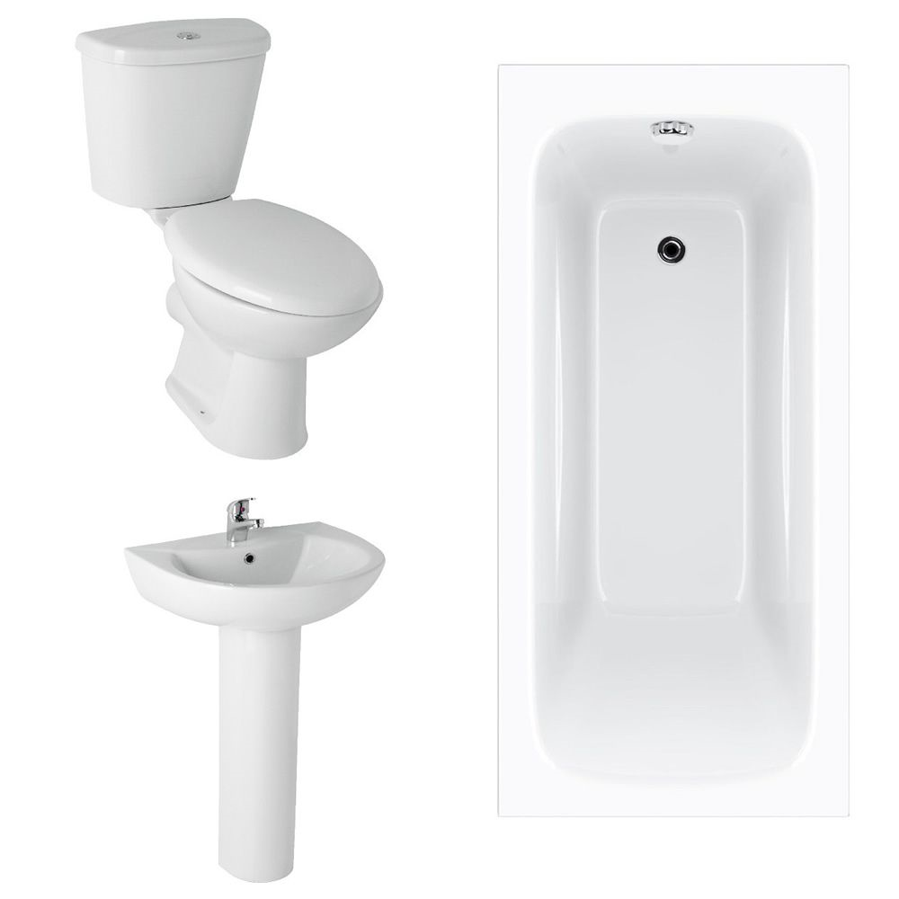
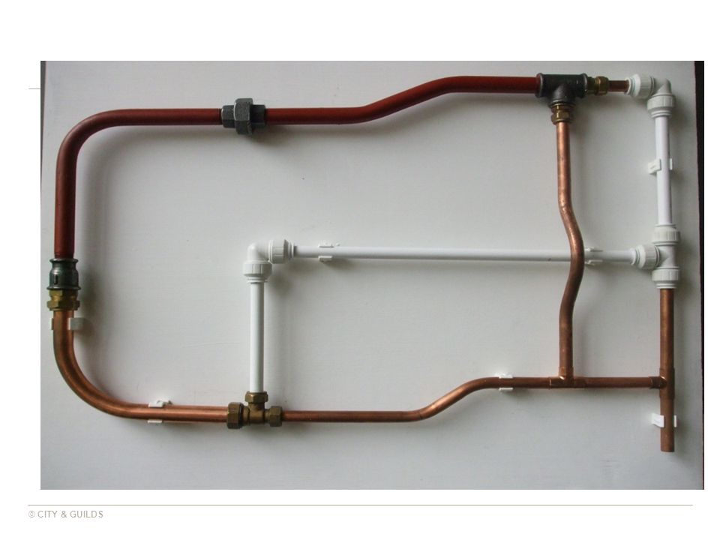
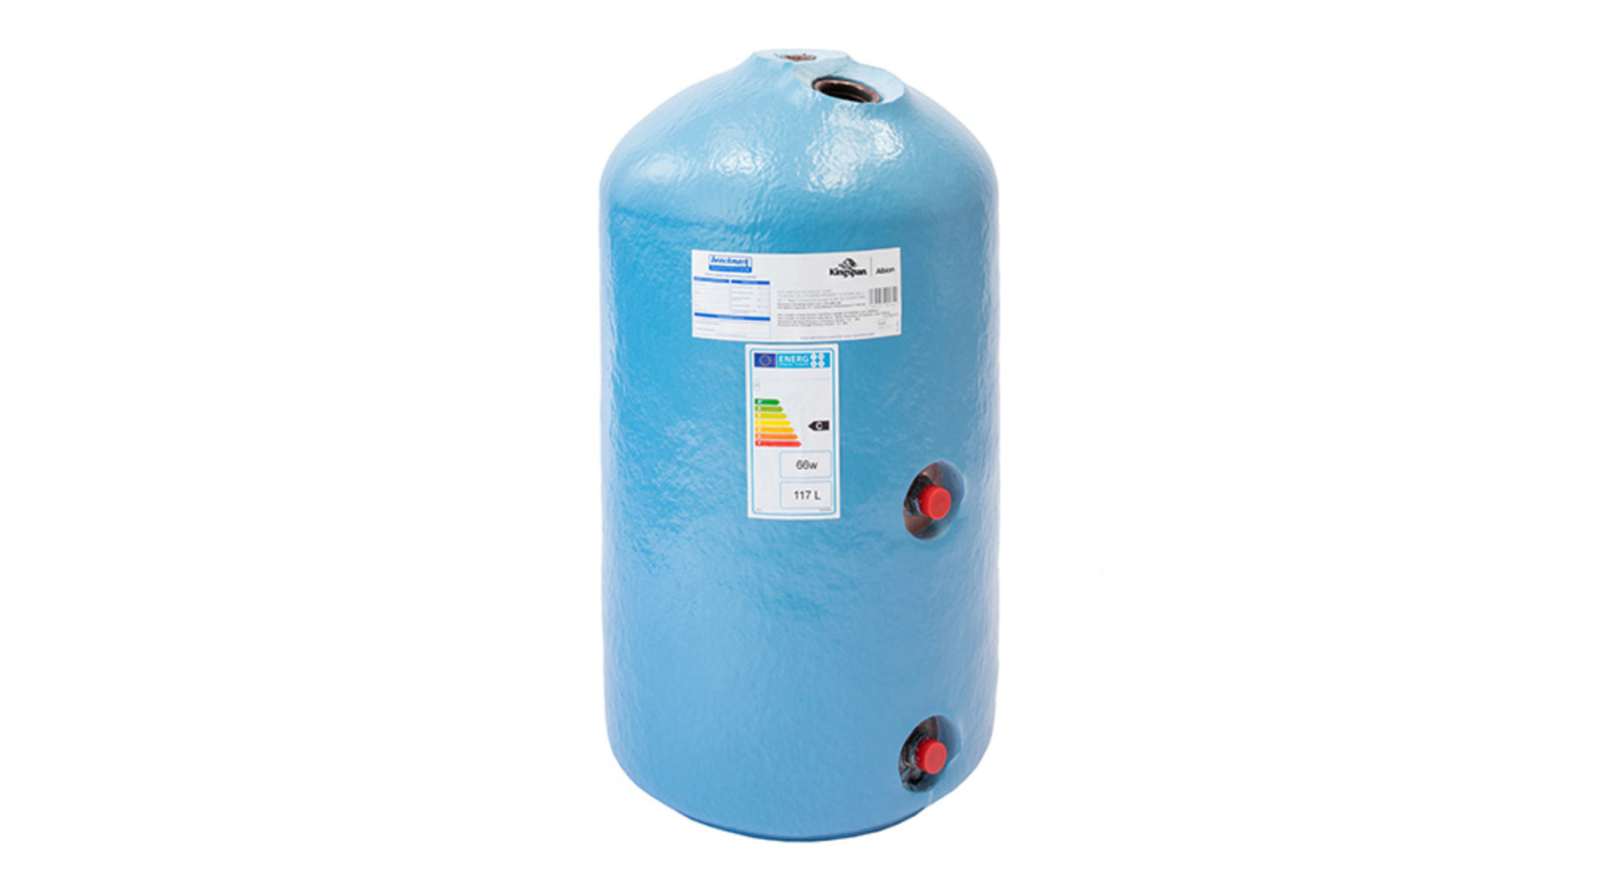
Course Overview
The Level 2 ‘Diploma in Plumbing Studies’ is aimed at potential learners with some plumbing experience or knowledge, who are interested in pursuing a career in the Plumbing industry.
The course is a mixture of Plumbing practical training and assessment, alongside Plumbing theory lessons with end of unit Online Multiple Choice Exams.
You will build on existing knowledge to learn about more complex Plumbing systems and installations, improve on your basic skillset to complete more complicated practical tasks.
Tasks such as; mixed material framework construction, cloakroom appliances installation, open vented hot water cylinder installation and the installation of a bathroom suite.

Slide 4
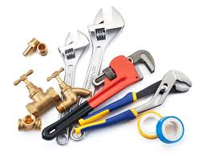

Is Plumbing for me?
Do you enjoy working with your hands and carrying out physical tasks?
Does building and construction interest you?
Do you enjoy problem solving and learning new skills?
Are you looking for a career which can offer you practical skills and knowledge?
Are you looking for a career which offers many routes and pathways, a variety or different roles and opportunities throughout your working life?
If you answer yes to these questions then Plumbing may the right career choice for you!

Slide 5

Who are City & Guilds?
City & Guilds are arguably the UK’s leading awarding body for Construction.
They are probably the most recognized provider for vocational qualifications in the UK.
“Founded in 1878, The City and Guilds of London Institute was founded by the Corporation of the City of London and 16 livery companies (the Guilds), to protect and promote the standard of technical education.
Our President is Her Royal Highness The Princess Royal, who took over this role from His Royal Highness The Duke of Edinburgh, in 2011.
Our goal is to ensure that, whoever you are, you have the right skills to thrive both now and in the future.”

Slide 6

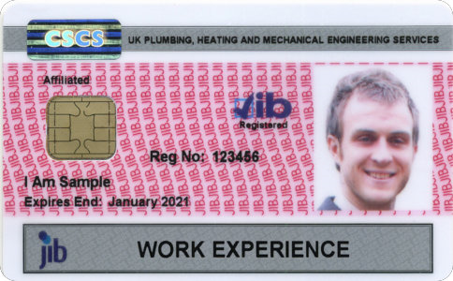






Where can it lead?
Progression on to higher level Plumbing courses
Work placements and work experience
Apprenticeship opportunities
Industry related qualifications and registrations (when fully qualified)

Slide 7


Apply online today at www.weymouth.ac.uk
If you cannot see the link please call 01305 761100 or email your enquiry to admissions@weymouth.ac.uk

