Slide 1


Support for students with an EHCP, SEND or Additional Needs

Slide 2

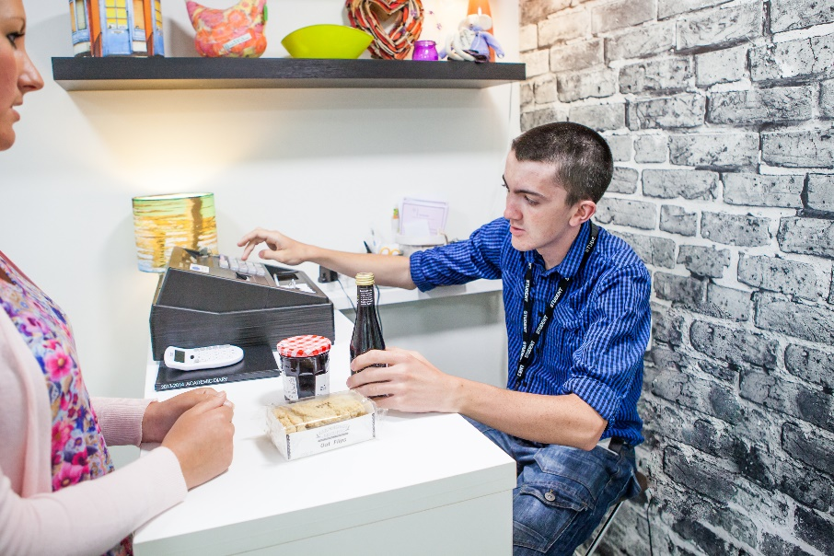
Specialist Support Assistants
What support can I have at college?
Specialist support will be available based on your needs.
How do we find out your needs?
You can tell us about your support needs when you apply for a college course.
If you have an Education, Health, Care Plan (EHCP) we will need to see it.
It will tell us about the support you need.
We will be able to tell you whether we can meet your needs.
When you start your college course you will have a 1:1 chat with a Specialist Support Assistant (SSA).
You can tell them about your support needs.
They will help write an Additional Learning Support (ALS) plan for your support.
The plan can be seen by staff who are working with you.

Slide 3
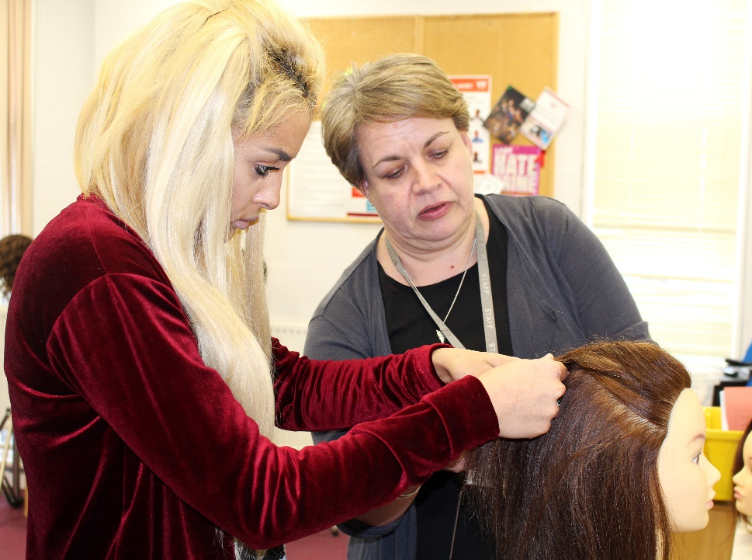
Specialist Support Assistants in the classroom
If you have told us about a support need we can provide specialist support for you in the classroom.
What could that be?
It depends on your need but we can provide:
2:1, 1:1 and 1:2 (shared support) where needed
Small group support
Whole group support
Specialist resources to help you work
This may be for some, or all of your lessons depending on your need.
Our Specialist Support Assistants work with your tutors to support you to do your work.

Slide 4
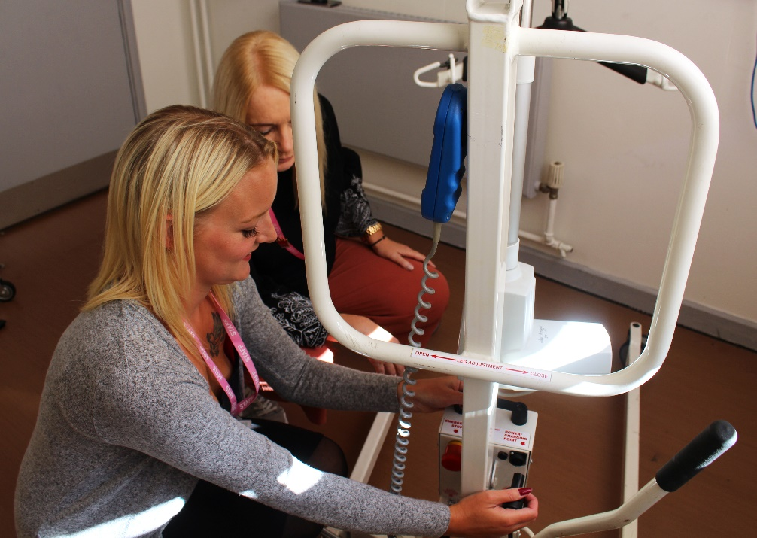
Specialist Support available outside the classroom
What could that be?
Personal and Medical care
Support with a social, emotional or mental health need (see Student Support)
Specialist workshop sessions
Support at lunch and break times
Quiet areas that can be accessed
Support at the start and end of the college day
Extra support from your tutors
Support for the transition between school and coming to College

Slide 5

Students with an EHC Plan
We will need to see your plan to be able to tell you whether we can meet your needs.
We will help all staff who are working with you to understand and support your needs.
We will monitor and review your EHC Plan targets.
We will organise a yearly review of your plan.
Please read / listen to: Specialist Support Assistants in the classroom
Specialist Support Assistants outside the classroom

Slide 6
Exam Access Arrangements
I had support in my exams at school, can I have the same at College?
As long as you still use this arrangement in your college classes or exams and we can show that it is your ‘normal way of working,’ we can apply for you to have it at college.
We can arrange for you to have an assessment for exam access arrangements if your school assessments are out of date or your school are unable to provide them.
Please note that you do not automatically get exam access arrangements if you had them at school. It has to be proven to the JCQ (Joint Council for Qualifications) that it is still your ‘normal way of working.’
You may need to provide evidence such as a medical report from an NHS consultant, specialist or GP to support an application for exam access arrangements.
Your college lecturer will also need to confirm that you still need this arrangement.

Slide 7

Support for the transition from school
What help can I get to help me feel less anxious about starting college?
We can talk to you and your school about taster sessions at College before the summer holiday.*
We can ask your school to provide information about your support needs.
We can offer a summer time short programme to help you get used to being here.*
* Subject to COVID 19 restrictions.

