Slide 1
Weymouth College
What we have to offer
Everybody is unique here at Weymouth college and we like to celebrate that and support learners in making decisions about how they want to live their lives.
The college is at the heart of the local community and we encourage our students to work towards making a positive contribution to the community.
We offer students the opportunity to build their confidence, explore their potential, make new friends and develop their living and work skills whilst gaining recognised qualifications
Our range of foundation studies courses will help students to prepare for other courses in the college or move into employment. We will help you develop your skills and confidence so you feel ready to take the next step.
Students learn in a safe and friendly environment and will be supported every step of the way by our experienced and dedicated Foundation Studies team.
At Weymouth College we are committed to helping our students succeed and have invested in dedicated facilities to aid students’ learning and development.
Support Available
In addition
SEND provision
The local offer

Slide 2
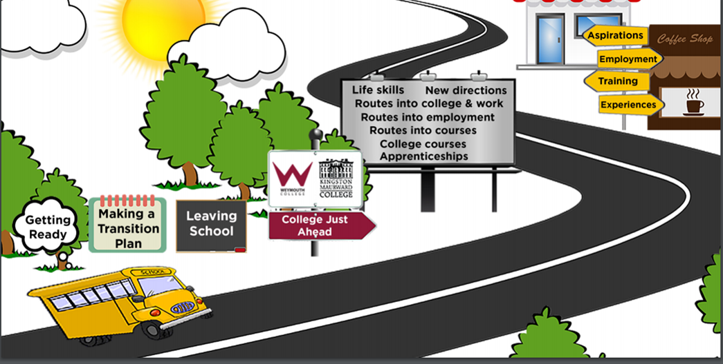


Slide 3
Apply here!
Life Skills
Overview of the course
This course is for students with learning difficulties and/or disabilities who would like to develop their confidence and learn to become more independent in an adult environment. Skills will be developed to help students to look after themselves; build confidence through teamwork, to learn working routines and to be involved with the local community. Students will have individual learning outcomes and personalised timetables with the appropriate level of support to develop skills, maintain safety and promote independence. Support is also provided outside of the classroom for meeting transport, lunch and break times and for transport home at the end of the day.
What will you expect from me?
To achieve a full qualification we would ask you to:
• Have good attendance at College
• Be on time for your lessons
• Follow the College and classroom rules
• Take part in the lessons and activities
What’s Next?
There is the option of having up to three years on the Life Skills course, where appropriate, and then progression may be possible to Routes into College and Work and then Supported Internships, or through Preparation for Community Living for those who may need more support to work.
How will I be assessed?
The course is assessed through a portfolio of evidence, including witness statements from tutors and photographs.
Click here for more information on the course content
Additional support

Slide 4




Health
Relationships, friendships and community
Course units
Employment
Independent living skills
Life Skills

Slide 5
Back to courses
Overview;
Employment –Learn short working routines during supported in-house work placements, developing skills through Employment lessons, learning about punctuality, time and money. Some students may progress to outside work placements which are supported, dependent on their individual outcomes.

Slide 6

Back to courses
Overview;
Health -Learn how to wash hair, how to have good personal hygiene and how to take care of your body through exercise and mindfulness. We offer yoga, swimming and gym sessions with many other sport options available to us. Students can learn in the College Salon, using professional equipment and can relax in our sensory garden to learn how deal with stressful situations.

Slide 7

Back to courses
Overview;
Independent Living Skills – Learn in a self-contained house style environment. Students will learn how to shop, prepare and cook healthy snacks and meals for themselves. They will keep their environment clean and safe with supported household tasks with the aim of transferring skills learned to the home.

Slide 8

Overview;
Friends, Relationships and Community – Take part in workshops to promote healthy relationships with friends and family, including sexual health where appropriate. There will be opportunities to explore voluntary work and to take part in community projects, getting to know the area in which the College is based. Transport training in the local area is included.

Slide 9
Routes into
What courses are there?
What is it?
The Routes into Courses are Foundation Studies programmes designed to equip young people with the skills needed to start their career. The main aim is to help learners progress onto a level 2 course, an apprenticeship or employment. You will be motivated to achieve by developing your knowledge within a vocational area by attending vocational tasters and developing your knowledge of your chosen sector whilst studying for Functional Skills qualifications (Maths, English and ICT) or GCSE English and Maths if appropriate. You will also work towards achieving the NOCN Level 1 or 2 Award/Certificate in Skills for Employment, Training and Personal Development.
You will be given the opportunity to attend a work experience placement during the academic year.
What will you expect from me?
To achieve a full qualification to the
highest standard we ask for:
• Acceptance to attend either Functional Skills Maths & English
or GCSE equivalent as an integral part of your chosen course of study
• Adherence to the Student Charter and Disciplinary Policy
• A high level of attendance as per College policy
• Demonstrate an interest and commitment to study all aspects of your programme
• Punctuality
• To always be prepared for all lessons
How will I be assessed?
Students are assessed through coursework, which will be completed during lessons. The assessments will be ongoing throughout the academic year through a variety of methods and will be collated to create your final qualification portfolio. Functional Skills in English, Maths and ICT are assessed through formal exams and can be taken when the student is ready. GCSE English and Maths exams are taken in November and during the Summer term.
What next?
On successful completion of the Level 1 Routes into programme, learners can progress onto Level 2 courses, apprenticeship or employment.
Click here to see our progression chart!
Apply here!

Slide 10



Slide 11
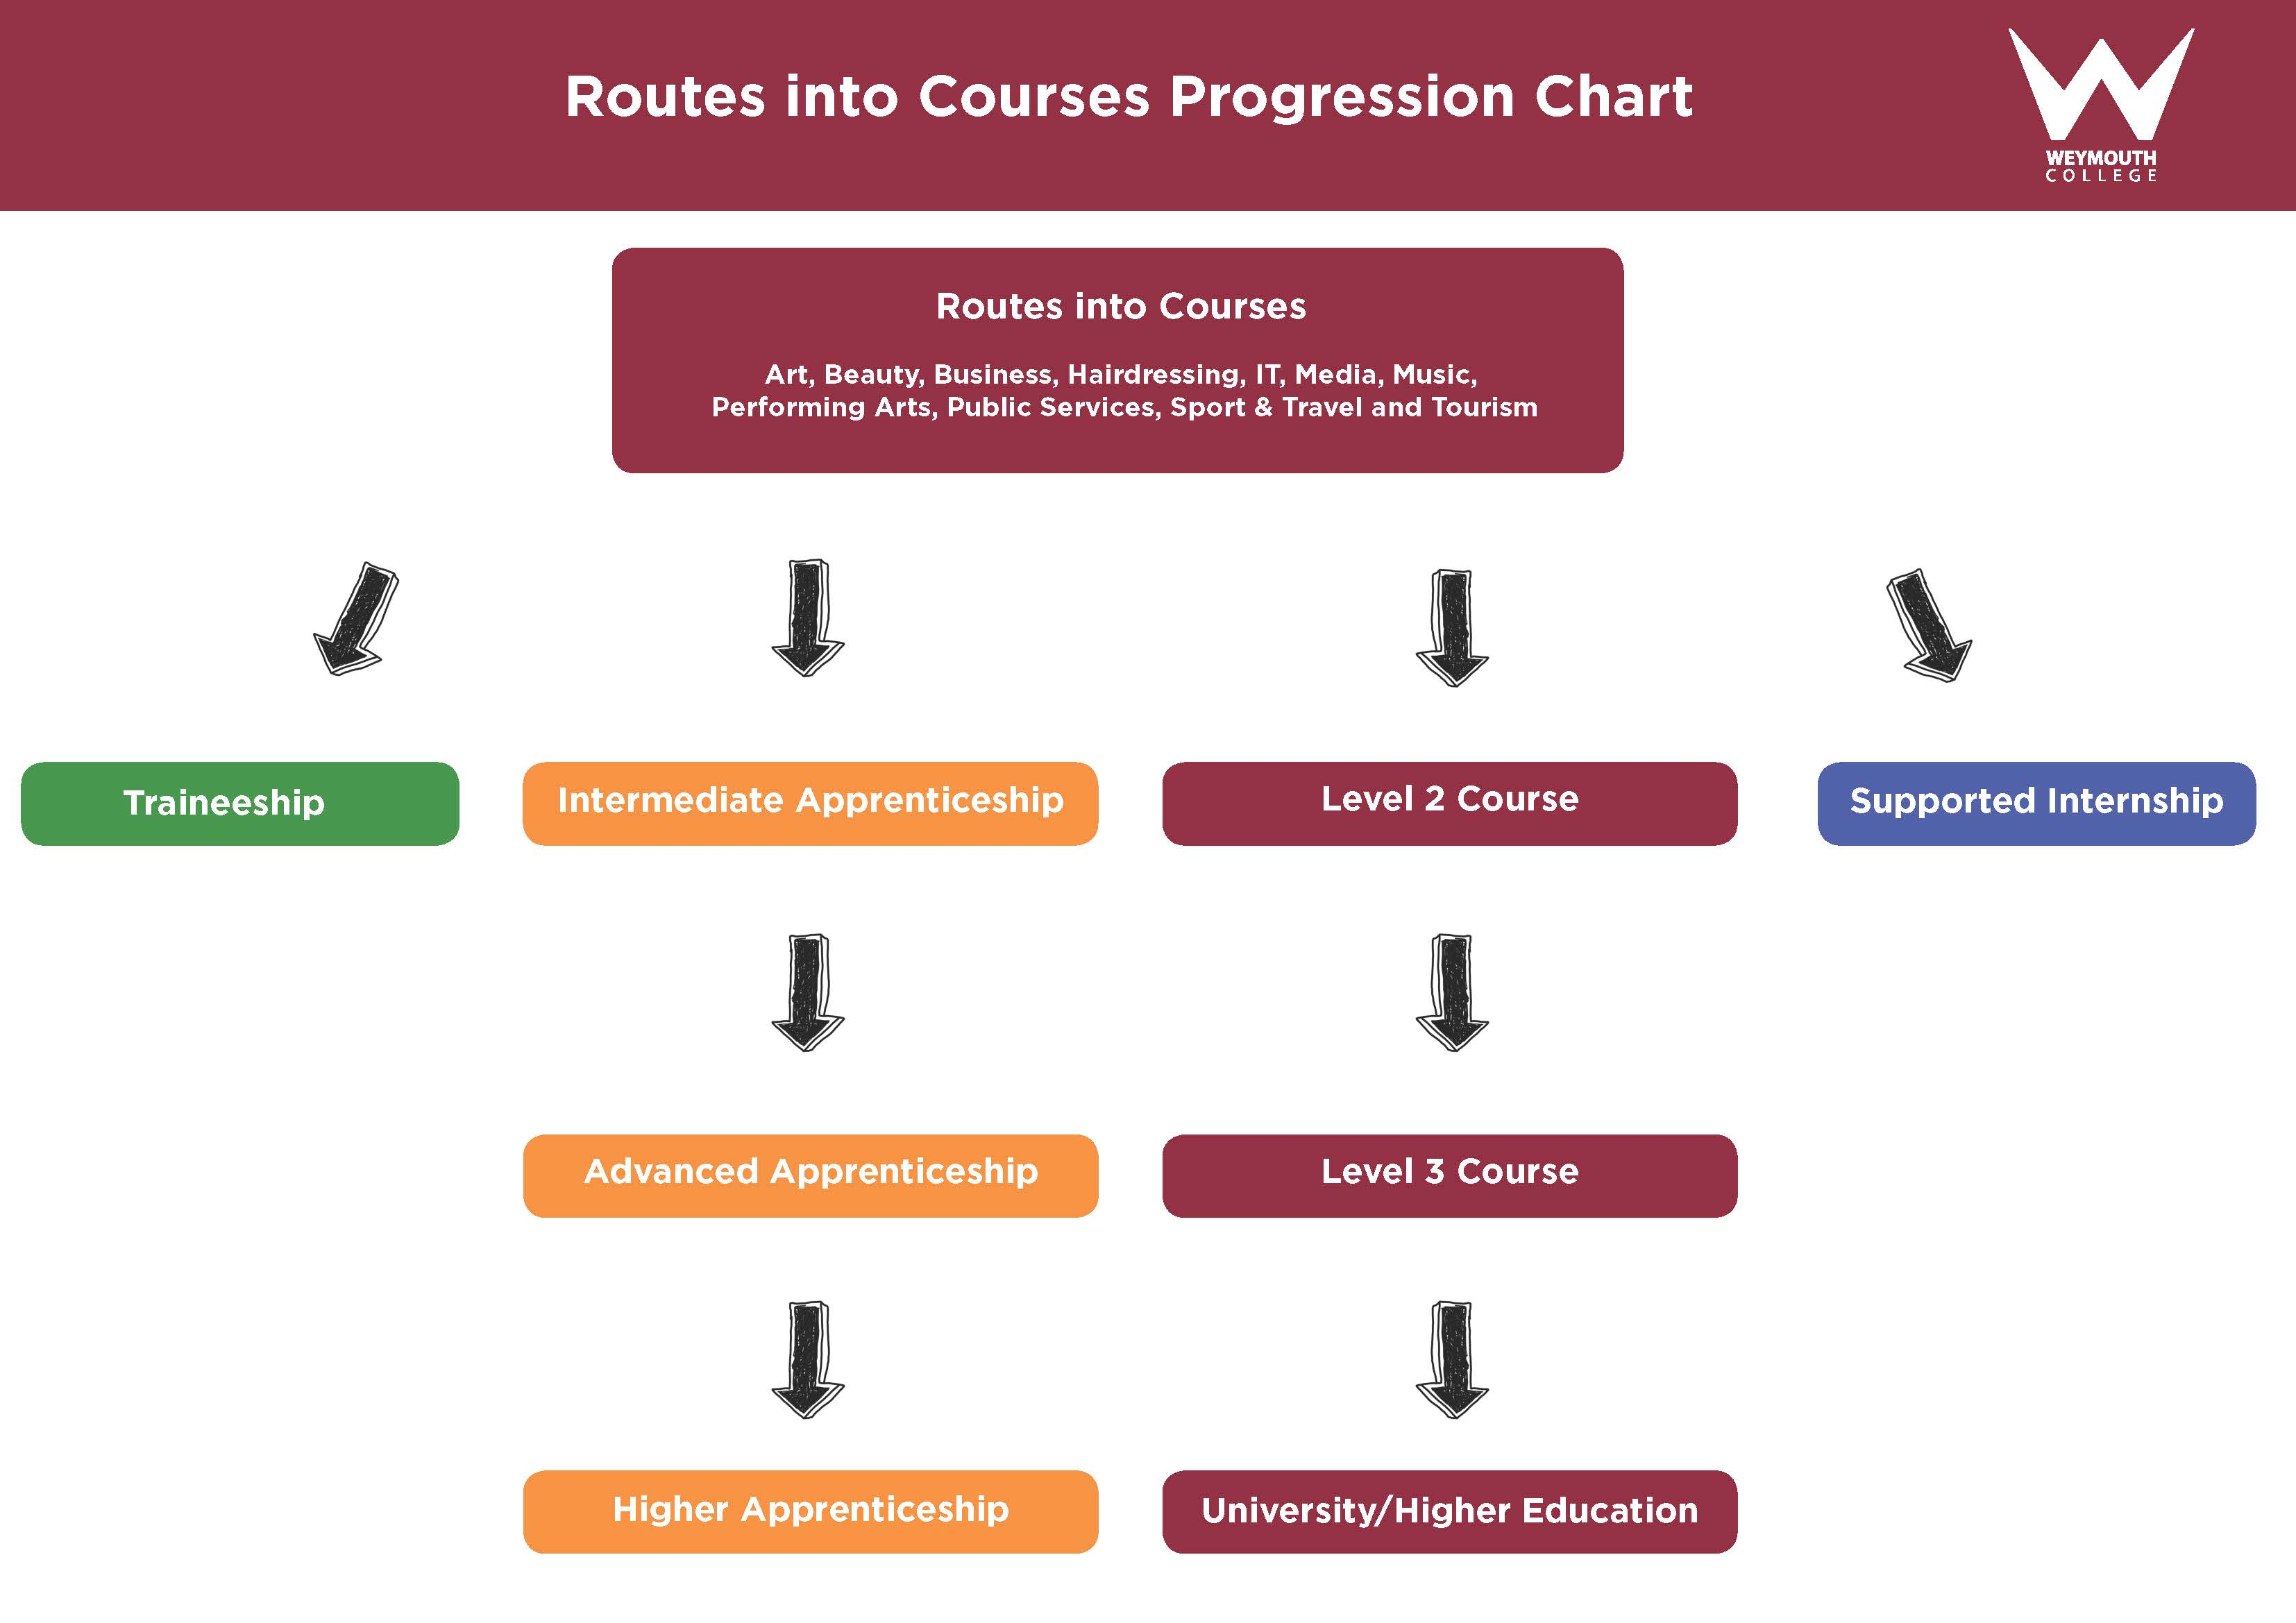

Slide 12
New
Directions
Overview of course.
The New Directions Course is part of the Foundation Studies programmes area, designed to equip young people with the skills needed to start their career. The main aim is to help learners progress onto a Supported Internship, further learning or employment.
You will be motivated to achieve by developing your knowledge within a vocational area whilst
studying for Functional Skills qualifications (Maths, English and ICT). You will also work towards achieving the NOCN Level 1 Certificate in Skills for Employment, Training and Personal Development.
How will I be assessed?
The qualification will be assessed through individual units. The unit credits count
towards your final qualification.
What’s Next?
On successful completion of the Level 1 New Directions programme, learners can progress onto Level 2 courses, Supported Internship or employment.
Course contents
New Directions will have 6 week taster blocks across a variety of sectors within the college, these will include: Floristry,
Catering, Construction, Performing Arts and Media.
Learners will also be supported to find and take part in Work Experience to help them investigate potential career routes
What will you expect from me?
To achieve a full qualification we would ask you to:
• Have good attendance at College
• Be on time for your lessons
• Follow the College and classroom rules
• Take part in the lessons and activities we offer
Click here for more information on our course content

Slide 13


Healthy Living
Teamwork Skills
Independent Living Skills
Course
units
Preparation for work
Managing Money
£
New Directions

Slide 14

Back to New Directions
Overview;
Teamwork Skills - take part in challenges and show you can work effectively as part of a team.
Back to Course content

Slide 15

Back to New Directions
Overview;
Preparation for Work – all the essential skills you will need to apply for a job and be successful at interview.
Back to Course content

Slide 16
Back to New Directions
Back to New Directions
Overview;
Managing Money – learn how to budget, make savings and handle your own and other peoples money properly.
£
Back to Course content

Slide 17

Back to New Directions
Back to New Directions
Overview;
Independent Living Skills – learn all the skills that will help you to live on your own successfully.

Slide 18
Back to New Directions
Back to New Directions
Overview;
Healthy Living – find out the benefits of a healthy lifestyle and how to create nutritionally balanced meals.
Back to Course content

Slide 19

Routes into employment
(supported internships)
Overview
You will learn a range of skills that will help you to prepare for work. You can look forward to growing in confidence, building your self-esteem and developing your existing skills and learning new ones whilst gaining valuable experience through a supported work placement. You will develop skills during work experience in our Fleet shop and exciting new catering outlet, progressing to work experience in the community when you are ready. Support is available to meet the individual needs of our students.
Entry Requirements
You must be aged 16 – 24 and have an EHC plan or a statement of educational needs (S139a). English and Maths at Entry Level 2 or above
How will I be assessed?
You will build portfolios of evidence which will include personal reflective work diaries
What's next?
On successful completion of this course you will be ready to seek paid employment
Course content
You’ll learn through a one day a week job readiness Study Programme and up to three days in a chosen work placement with a job coach. You will also study work ready skills, interview techniques, communication skills and team building

Slide 20

Additional support that is available
Charity our working assistance dog
SSA’s
Specialist Support Assistants
In addition
Trainee Social Workers
Quite rooms and areas across college
Mentoring staff and Guidance support team
Tea and Toast and lunch time clubs for SEN Students
Sensory Garden

Slide 21
In addition:
Inclusion is important at Weymouth College and if you meet the course criteria, support is available for you to access mainstream, vocational courses from Entry Level to Foundation Degree level.
Students are encouraged to take advantage of the transition opportunities at Weymouth College.
A member of the support team can be invited to attend your person centred review from year 9 onwards, to support you and your family with information regarding options that may be available to you when you leave school.
A member of the support team can visit your current school to discuss what support needs you have and plan any support that needs to be put in place at Weymouth College.
A visit to Weymouth College can be arranged for you to look around and familiarise yourself with the campus, meeting key staff and finding out about the facilities, services and support available to you.
A summer club is available 2 days a week during the summer holidays where you can attend for all or some of the sessions to minimise stress and anxiety of starting a new college. It may help you to feel more confident and to meet other young people who may be feeling the same.
1:1 meetings with key staff are available to establish links and to build relationships with the support team or personal tutors that will be offering support when you start college.
Accessibility:
Accessibility Wheelchair accessible
All buildings are accessible for wheelchairs and buggies. Most buildings have automatic main doors at the entrance and all buildings with additional floors have lift available.
Parking Availability information
Drop off facilities are available next to Fleet building where the college’s main reception area is situated. Disability bays are available close to all buildings. A main college car park is available for all other vehicles.
Toilet facility information
All buildings have accessible toilets with electric or manual hoists available. Two toilets are fitted with Closomat toilets (integrated washing and drying). Accessible changing beds are available for any students needing support with personal care.
Other Facilities
Electric and manual hoists, accessible changing beds, quiet garden. We have a medical and personal care assistant who can administer medication to students that need support taking their medication whilst on the college campus. Support is available for students requiring help with personal care or feeding.
We offer a wide range of support to all learners with an additional need, from learning difficulties to mental health issues, dyslexia to special examination requirements, etc.
Services offered include:
Transition support from school to college
Classroom Support
Learning Resources
Loan of specialist equipment
Personal Mentoring
Support for Mobility or Sensory Requirements
Workshops
Health Champions
Medication and Personal Care assistant
Exam access arrangements
Person Centred Reviews

