Slide 1

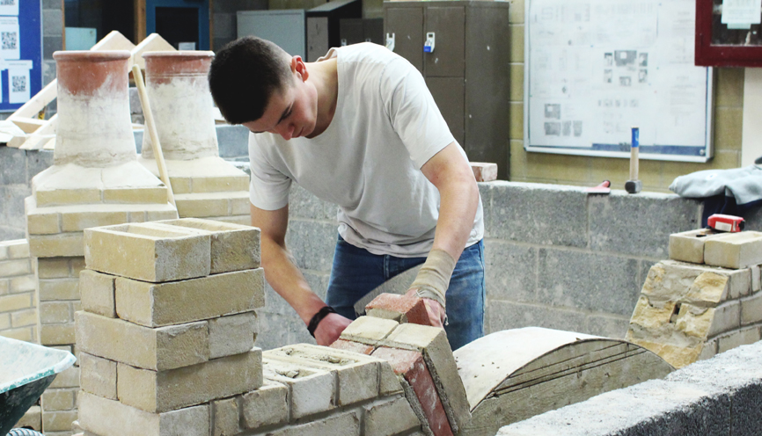
Trowel Occupations
Level 1 Diploma

Slide 2
Course Summary
The level 1 Diploma qualification is for candidates who want to work as a Bricklayer in the Construction sector
Entry Requirements
You will need a GCSE grade 4 or C in English and Maths. Occasionally we will accept a grade 3 or D in one of the subjects*
Or
Completion of Construction Skills Course
Or
Prior experience in the construction industry
*If this is the case, you will be required to study English or Maths GCSE until you have achieved a 4 or 4Cin both subjects.
(Candidates that do not meet the entry requirements will be offered the Construction Skills course with direct progression to level 1 Brickwork next year)

Slide 3
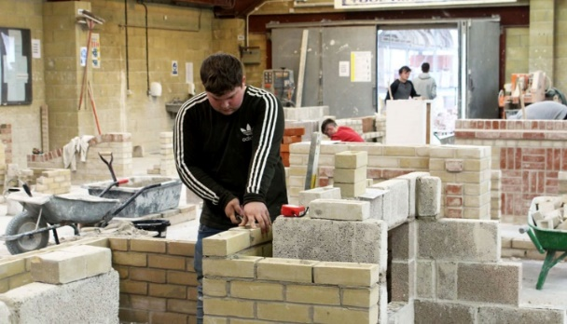
Student Experience
Vocational based learning
A well equipped workshop,
Working with your own Basic toolkit
Specialist hand tools are supplied
Supported by Brickwork Lecturers with real life experience
Working on practical activities rather than essays
Progressing at your own pace
Access to library and computers

Slide 4


Brickwork is NOT…
Entirely classroom based!
Boring
Only about numbers and boring subjects

Slide 5
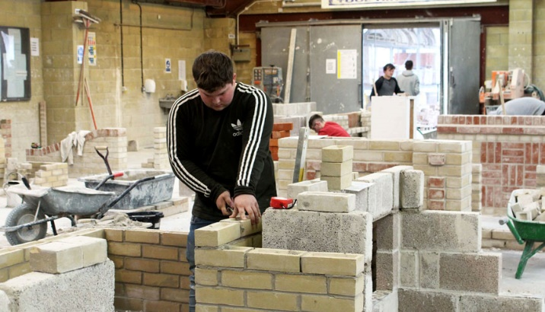
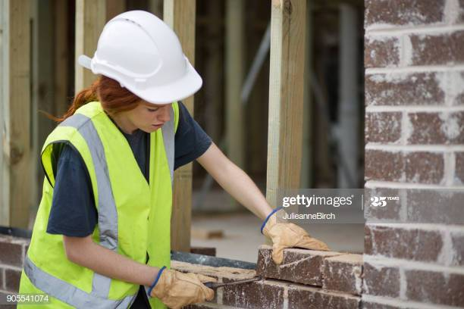
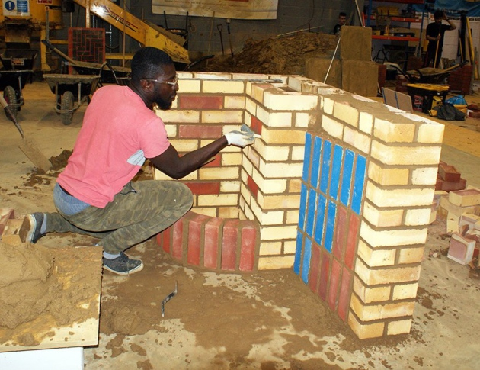
Brickwork is DEFINITELY…
Active learning
Assessment by activity
Interesting and varied
Challenging
FUN!!!

Slide 6
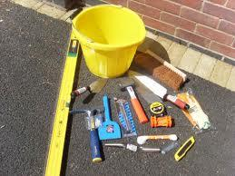
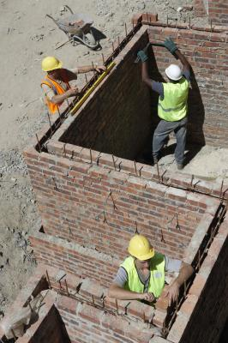
Course Overview
YEAR 1
Principles of building construction, information and communication
Carrying out blocklaying activities
Carrying out bricklaying activities
Carrying out cavity walling activities
Contribute to setting out and building of masonry structures up to damp proof course

Slide 7
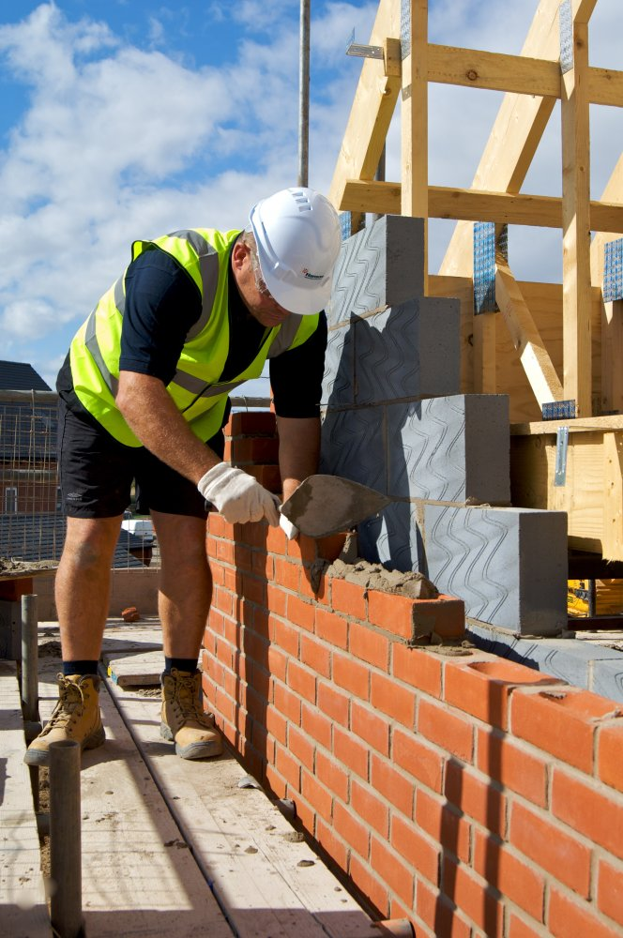
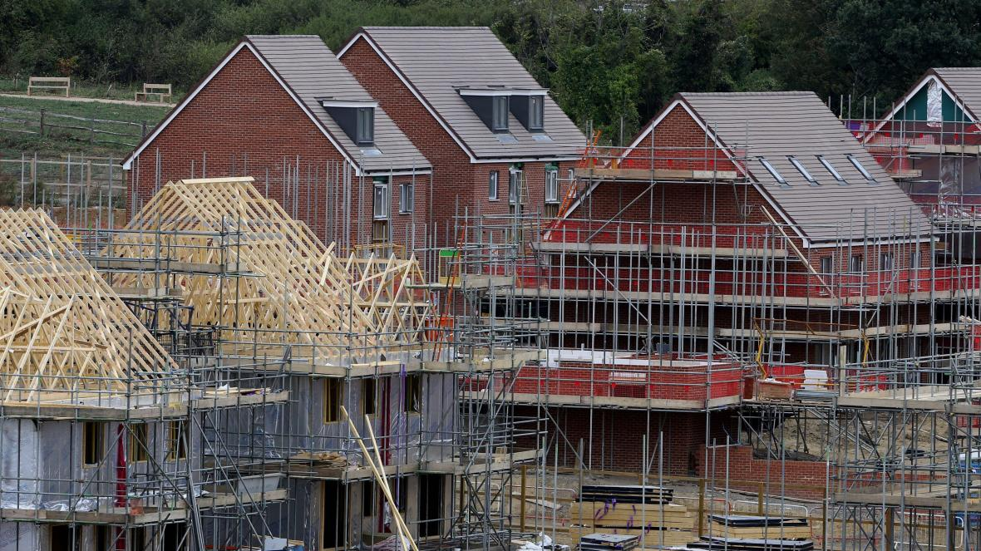
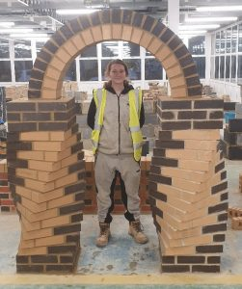
Working towards a Career in Construction

Slide 8
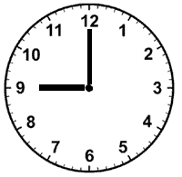
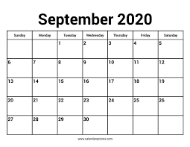
Attendance
Full Time 2.5 Days per week
  Monday to Wednesday lunchtime
Part Time 1 Day per week
  Tuesday all day
  Infilling with the apprentice group
  09:00 to 12:30am 13:30 to 16:45

Slide 9
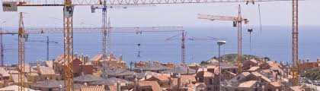


Where Does it Lead?
The only limit is your imagination
Industry related qualifications and registrations (when fully qualified)
Progression to
Level 2 Diploma
Work placements and work experience

Slide 10


Apply online today at www.weymouth.ac.uk
If you cannot see the link please call 01305 761100 or email your enquiry to admissions@weymouth.ac.uk

