Slide 1

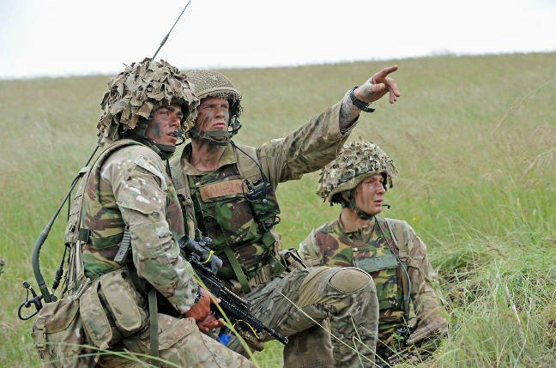
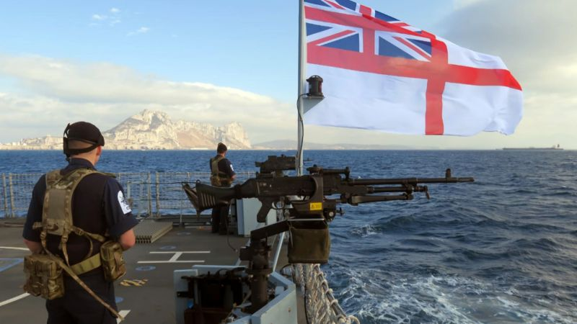
Level 2 First Diploma
in Public Services
Course Leader and Tutor Neil Carter

Slide 2
Course Summary
This nationally recognised qualification is a practical, industry-related one year course.
Qualification is made up of seven units.
Assessment for the course is by course work, assignments are based on realistic workplace situations, activities and demands
Entry Requirements are 4 GCSEs at grade 3 (D) to include English and Maths or a BTEC Foundation Certificate in a related subject.
You will develop a range of knowledge and skills, personal qualities and attitudes essential for a career in the public services.
You will benefit from being taught by a well-qualified team of lecturers with substantial teaching and vocational experience

Slide 3
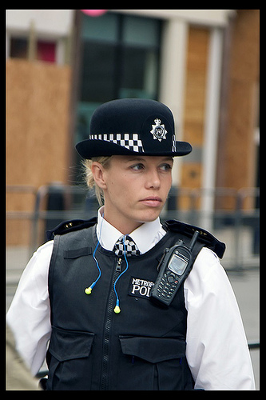
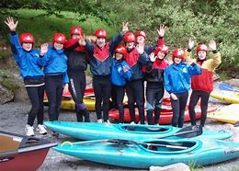
Programme of study
Adventurous Activities and Teamwork for the Public Services
Volunteering for the Public Services
Land Navigation by Map and Compass
Employment in Uniformed Public Services
Career Planning for the Public Services
Public Services Skills
Sport and Recreation in the Public Services

Slide 4
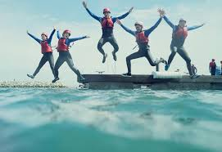
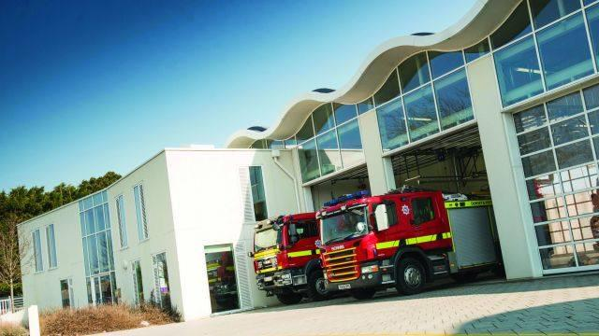

Industry Experience
Experience in the workplace is important for any course. During the Level 2 course, we will include a variety of industry based activities to allow you to review your options for career paths or employments.
Industry based activities include;
  National Citizen Service 3 day residential and Community project.
  Trips, activities, industry speakers from all the Uniformed Public Services
  Land and water based activities and an expedition.

Slide 5
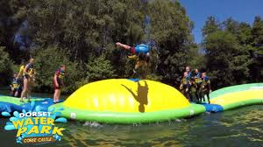
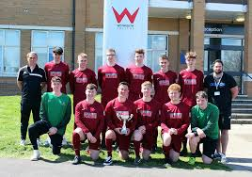
Activities & Trips
Dorset Water Park/Burnbake Camping
Weekly practical sport and team activities
Weekly Enrichment activities led by high quality coaches
College Football Academy
IMPORTANT: All trips & activities will be subject to student financial contribution & availability

Slide 6
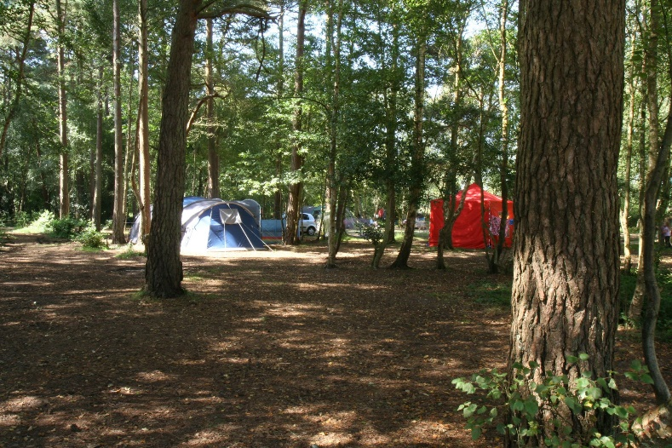
Additional Activities/ Qualifications
Sport and Recreation – tasters, fitness sessions, competitions & tournaments such as:
  Ultimate Frisbee / basketball/ football/ circuit training / dodgeball / badminton/fitness tests / volleyball & more!
Volunteering opportunities to enable you to make a difference to others
GCSE Mathematics & English retakes
Functional Skills Qualifications

Slide 7

Where do I progress?
Extended Diploma in Public Services
This qualification has been developed to meet the needs of a broad spectrum of public service areas from uniformed roles in defence, emergency, security and justice, to non-uniformed roles in central and local government, as well as related voluntary and private sector agencies. You will gain a wide range of transferable skills needed for public service employment and have the opportunity to be involved in taster sessions, trips and visits. There will also be a programme of industry speakers. You will gain the knowledge, understanding and skills required for success in current and future employment, or for progression to courses such as BTEC Higher Nationals, Foundation degrees or Honours degrees.

Slide 8
Frequently Asked Questions
How many days a week will I be at college?
  Approximately 3 days a week in college and two independent study/industry experience days.
Will I have to purchase a college public services kit?
  Yes, this is approximately £40 and will be discussed at enrolment.
Will I have the opportunity to resit my GCSEs?
  Yes, unless you already have English and Maths at Grade 4, GCSE retakes will be built into your timetable.
What is college life like?
  College is an adult learning environment. We will support you in all aspects of your learning, however as an adult learner we want you take responsibility for your learning. You will have to ensure you are organised and adhere to all assessment deadlines.
Will my attendance and punctuality be monitored?
  Yes the sport and public services department instil the highest regards for attendance and punctuality as this is required in the workplace.
  Your tutor will monitor your attendance weekly.
Can I access extra help at college?
  Yes, speak with your tutor at enrolment, induction or throughout any part of your course to gain extra help.

