Slide 1

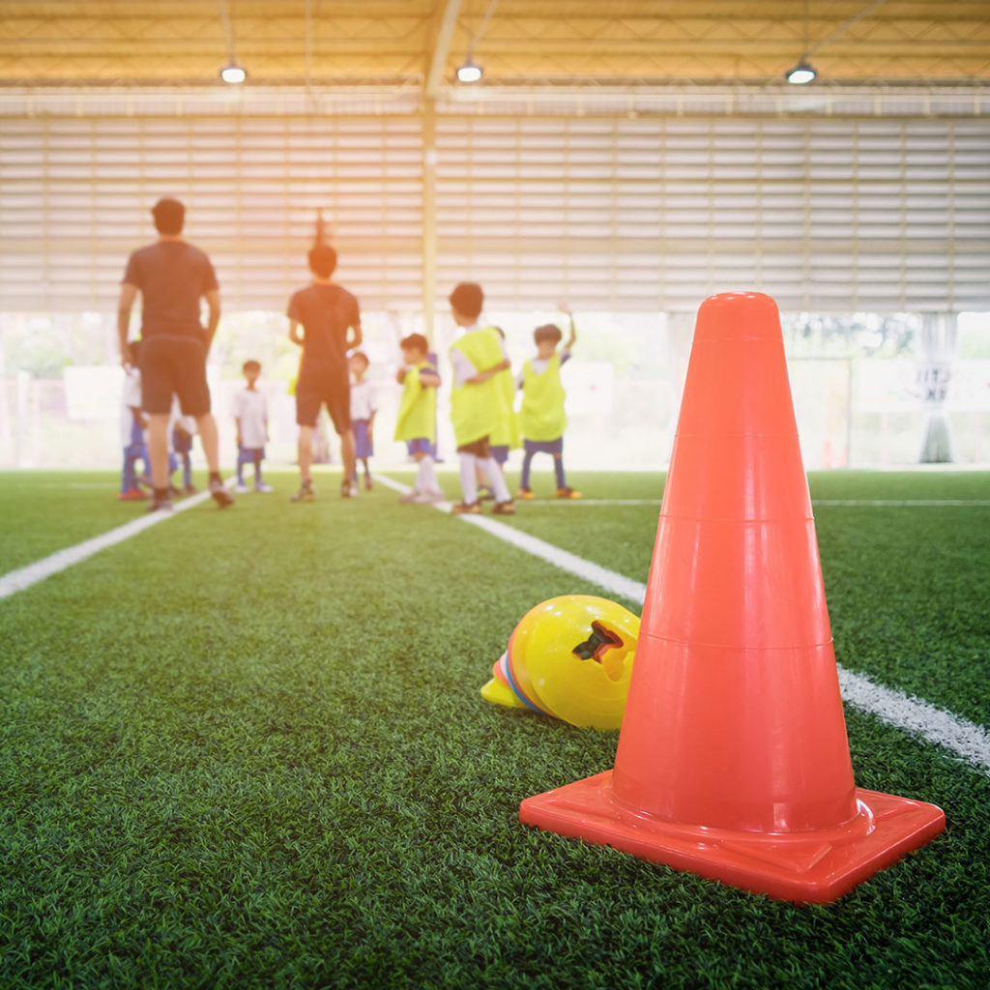
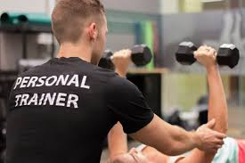
NCFE Level 2 Diploma in
Sport and Exercise
Course Leader and Tutor Laura Summers

Slide 2
Course Summary
This nationally recognised qualification is a practical, work-related one year course.
Qualification is made up of seven units.
Assessment for the course is by course work, assignments are based on realistic workplace situations, activities and demands
Entry Requirements are 4 GCSEs at grade 3 or D to include English and Maths or a BTEC Foundation Certificate in a related subject.
You will develop a range of skills, techniques, personal qualities and attitudes essential for a career in sport-specific employment.
You will benefit from being taught by a well-qualified team of lecturers with substantial teaching and practical experience

Slide 3


Programme of study
Anatomy and Physiology for Exercise
Development of personal fitness through training
Introduction to healthy exercise and nutrition
Participating in sport
Plan, deliver and evaluate an activity session
Planning and running a sports event
Developing Sporting Skills and Tactical Awareness

Slide 4
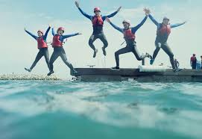


Industry Experience
Experience the workplace is important for any course. During the Level 2 course, we will include a variety of industry based activities to allow you to review your options for career paths or employments.
Industry based activities include;
  National Citizen Service 3 day residential and Community project.
  Local visitors trip and industry speakers
  Planning and delivering a full sport event for a local school.

Slide 5
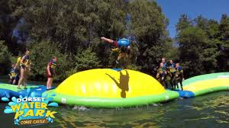
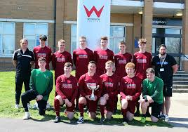
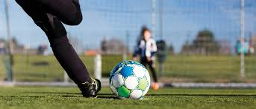
Activities & Trips
Dorset Water Park
Weekly practical sport and team activities
Weekly Enrichment activities led by high quality coaches
College Football Academy
IMPORTANT: All trips & activities will be subject to student financial contribution & availability

Slide 6
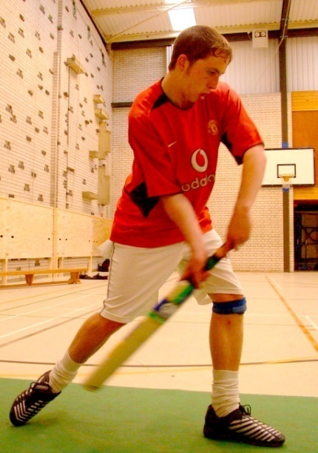
Additional Activities/ Qualifications
Practical sports – tasters, fitness sessions, competitions & tournaments such as:
  Ultimate Frisbee / basketball/ football/ circuit training / dodgeball / badminton/fitness tests / volleyball & more!
Leadership & coaching Qualifications
GCSE Mathematics & English retakes
Functional Skills Qualifications

Slide 7
Where do I progress?
Extended Diploma Sport | Extended Diploma Sport & Exercise Science | Extended Diploma Sport Outdoor Adventure (pathway)
The course uses practical application and performance to support and reinforce knowledge and understanding required to study aspects of; Instructing Coaching Leadership Fitness & training Physiology Health & Safety This course provides an dynamic relevant and challenging contribution to the study of sport at this level. | Develop knowledge and understanding of scientific principles through study of sport, exercise and health. Nutrition for Sport & Exercise Sport Injuries Sports Psychology Sport & Exercise Physiology Fitness Testing | The aim of the course is to introduce outdoor and adventures activities to the learner, give them a taste of the range of activities available and develop you own ability in these activities. Outdoor and Adventures activities Skills for land based activities Skills for water based outdoor and adventurous

Slide 8
Frequently Asked Questions
How many days a week will I be at college?
  Approximately 3 days a week in college and one independent study day.
Will I have to purchase a college sports kit?
  Yes, this is approximately £40 and will be discussed at enrolment.
Will I have the opportunity to resit my GCSEs?
  Yes, unless you already have English and Maths at Grade 4, GCSE retakes will be built into your timetable.
What is college life like?
  College is an adult learning environment. We will support you in all aspects of your learning, however as an adult learner we want you take responsibility for your learning. You will have to ensure you are organised and adhere to all assessment deadlines.
Will my attendance and punctuality be monitored?
  Yes the sport department instil the highest regards for attendance and punctuality as this is required in the workplace. Your tutor will monitor your attendance weekly.
Can I access extra help at college?
  Yes, speak with your tutor at enrolment, induction or throughout any part of your course to gain extra help.

