Slide 1

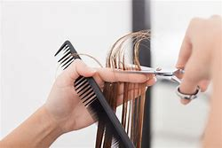
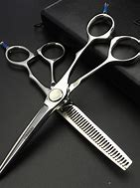
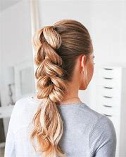

VRQ Level 2 Diploma in Hairdressing
Course Leader and Tutor Lucie Grace

Slide 2
Course Summary
This nationally recognised qualification is delivered over one year
You will need to complete 11 units- this includes practical & theory elements
Each unit you will complete an on-line exam & assignment, alongside demonstration your practical skills.
Each unit will be awarded a Pass, Merit or Distinction
Entry Requirements are 4 GCSEs at grade 3 or D to include English and Maths
You will develop a range of skills, techniques, personal qualities and attitudes essential for a career in the Hairdressing Industry
You will benefit from being taught by a well-qualified team of lecturers with substantial teaching and practical experience

Slide 3
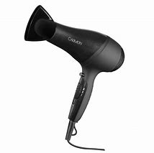
Units of study…
Working in the Hairdressing industry
Health & safety
Client consultation
Shampoo & condition
Promote products & services
Cut Women’s hair
Colour & lighten hair
Perming
The art of dressing hair
Create an image based on a theme
Reception services

Slide 4
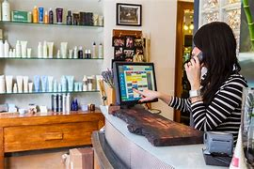
Industry Experience…
Experience in the workplace is important for any course. During the Level 2 course, we will include a variety of industry based activities to allow you to review your options for career paths or employment
- Realistic working environment
Guest speakers
In-house competitions
The annual show
Workshops
Trip and visits
We will encourage you to find local salon experience to support you with your training

Slide 5

Additional Activities/ Qualifications…
VTCT Award in contact Dermatitis
GCSE Mathematics & English retakes
Functional Skills Qualifications

Slide 6
Where do I progress?
VRQ Level 3 Diploma in hairdressing | Apprenticeship
Level 3 is an advanced hairdressing programme specialising in colouring, colour correction, cutting techniques and current trends As a level 3 student you will work in our commercial salon, offering all services. You will be expected to offer excellent customer service and professionalism. 1 weeks work experience is mandatory You will complete an additional qualification alongside- VTCT Skin Cancer awareness | An apprenticeship will continue to develop your skills and knowledge whilst working in the industry. 1:1 support from an apprenticeship co-ordinator & college tutor Continued training at college 1 day a week You will earn while you learn!

Slide 7
Frequently Asked Questions
How many days a week will I be at college?
Approximately 3 days a week
Will I have to purchase a college kit/uniform?
Approximate price- kit £380/uniform £30- this will be discussed & confirmed at interview
Will I have the opportunity to resit my GCSEs?
Yes, unless you already have English and Maths at Grade 4, GCSE retakes will be built into your timetable.
What is college life like?
College is an adult learning environment. We will support you in all aspects of your learning, however as an adult learner we want you take responsibility for your learning. You will have to ensure you are organised and adhere to all assessment deadlines.
Will my attendance and punctuality be monitored?
Yes the Hair & Beauty department instil the highest regards for attendance and punctuality as this is required in the workplace. Your tutor will monitor your attendance weekly.
Can I access extra help at college?
Yes, speak with your tutor at enrolment, induction or throughout any part of your course to gain extra help.

