Slide 1

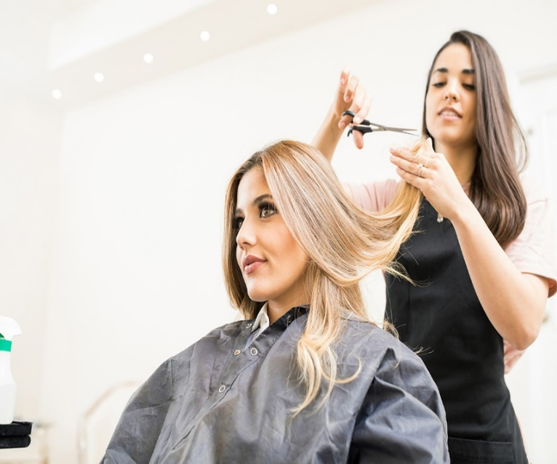
Level 3 Diploma in Women's Hairdressing
Progression presentation

Slide 2

Course summary
Progression from Level two is essential, you will also need to have completed your function skills or GCSEs and have a good attendance record.
You will be required to complete a trades test to prove your skills and readiness for the next level.
The course is one year long
You will complete practical assessment, assignments and exams over the year. The practical assessments will take place in a realistic working environment.
You will develop a range of skills, techniques, personal qualities and attitudes essential for the hairdressing industry.
The qualification is nationally recognised and you will be work ready as a Junior stylist on completion.

Slide 3
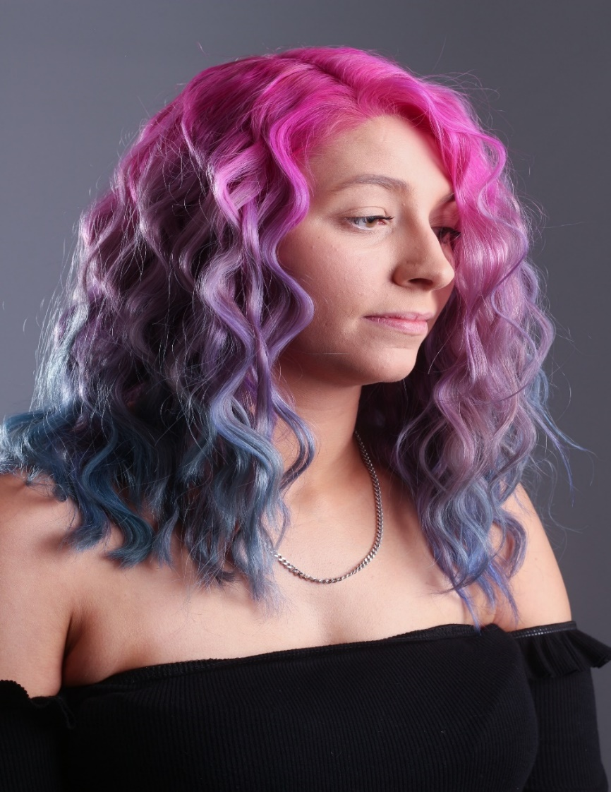
Units you will cover
Health & safety
Advanced Client consultation
• Creative cutting
• Creative Colouring
• Advanced perming techniques
• Creative hair design
• Promote products and services
• Colour correction

Slide 4
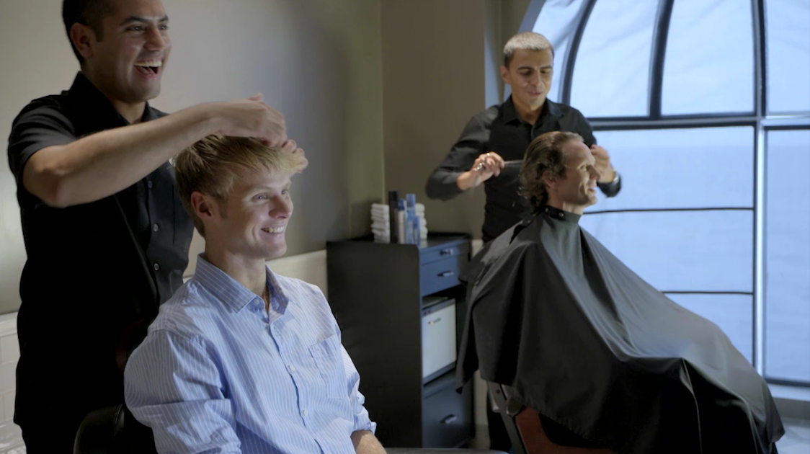
Industry experience
During Level three we will provide as much industry experience for you as possible, this could include:
Guest speakers
In-house competitions
The annual show
Workshops
Trip and visits
You will also be required to do work experience and source a placement to carry this out
We encourage you to find a employment in a salon, this could be as a junior or doing voluntary work in a salon setting. Although this is not compulsory, it is highly recommended.

Slide 5
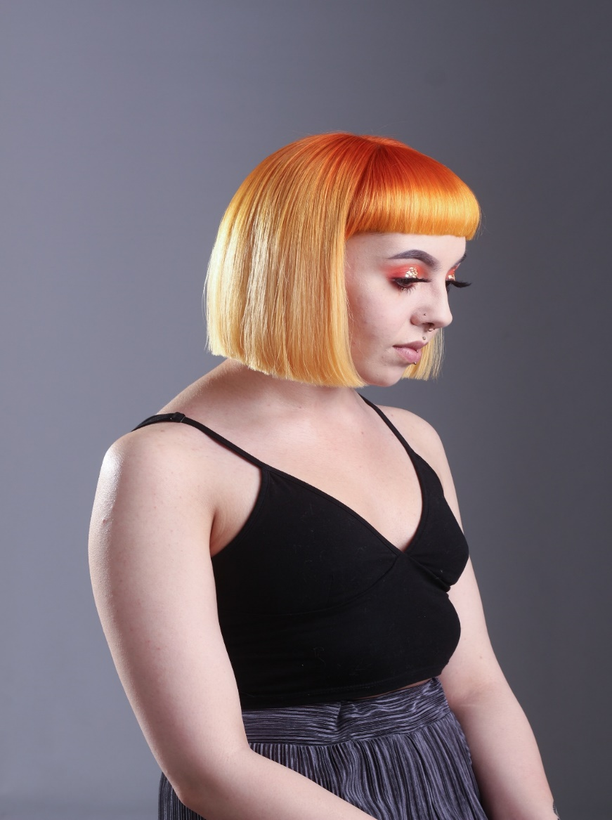
Progression
After Level three is completed you may consider the following:
-Barbering
-Employment in a salon
-Mobile hairdressing
When you have experienced the industry you could also consider:
-Cruise liners
-Hairdressing manufacturers (rep)
-Teaching
-Specialist work such as hair extensions or trichology.
There are many exciting career routes in the hairdressing industry, and you will be continually learning new skills and techniques

Slide 6

Progression
After Level three is completed you may consider the following:
-Barbering
-Employment in a salon
-Mobile hairdressing
When you have experienced the industry you could also consider:
-Cruise liners
-Hairdressing manufacturers (rep)
-Teaching
-Specialist work such as hair extensions or trichology.
There are many exciting career routes in the hairdressing industry, and you will be continually learning new skills and techniques

Slide 7
Frequently Asked Questions
How many days a week will I be at college?
  Approximately 3 days a week in college and one independent study day.
Will I have to purchase additional kit?
  Yes, this is approximately £150, you may need to replace any lost/broken kit from L2 and will be discussed at enrolment.
Will I have the opportunity to resit my GCSEs?
  Yes, unless you already have English and Maths at Grade 4, GCSE retakes will be built into your timetable.
What is college life like?
  College is an adult learning environment. We will support you in all aspects of your learning, however as an adult learner we want you take responsibility for your learning. You will have to ensure you are organised and adhere to all assessment deadlines.
Will my attendance and punctuality be monitored?
  Yes the hair department instil the highest regards for attendance and punctuality as this is required in the workplace. Your tutor will monitor your attendance weekly.
Can I access extra help at college?
  Yes, speak with your tutor at enrolment, induction or throughout any part of your course to gain extra help

