Slide 1



VRQ Level 2 Diploma in Hairdressing – Part Time
Course Leader – Suzanne Scott

Slide 2

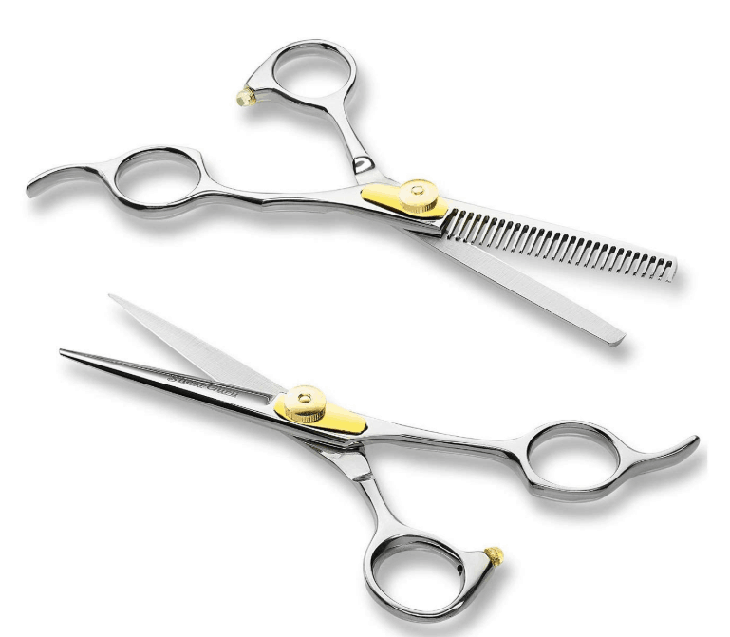
Mature Adult Learning
This course is aimed for people aged 19+
The time tables are set within school times (9:30am to 2:45pm) to unable you to drop off and pick up your children from school.
You will have full support from tutor / course leader
We have good links with employers to aid employment at the end of the course
Student financial support can be discussed on a personal level.
Options for childcare support can be explored with our student support services.

Slide 3
Course Summary
This nationally recognised qualification is delivered over 2 days for 34 weeks
There are 11 units to complete, each unit has an on-line exam, assignment and practical observations for you to achieve.
Each unit will be awarded a Pass, Merit or Distinction
You will develop a range of skills, techniques, personal qualities and attitudes essential for a career in the Hairdressing Industry
You will benefit from being taught by a well-qualified team of lecturers with substantial teaching and practical experience

Slide 4
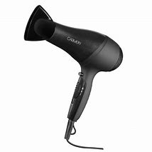
Units of study…
Working in the Hairdressing industry
Health & Safety
Client consultation
Shampoo & condition
Promote products & services
Cut Women’s hair
Colour & lighten hair
Perming
The art of dressing hair
Create an image based on a theme
Reception services

Slide 5
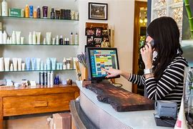
Industry Experience…
Experience in the workplace is important for any course. During the Level 2 course, we will include a variety of industry based activities to allow you to review your options for career paths or employment
- Realistic working environment
Guest speakers
In-house competitions
The annual show
Workshops
Trip and visits (optional)
We will encourage you to find local salon experience to support you with your training

Slide 6
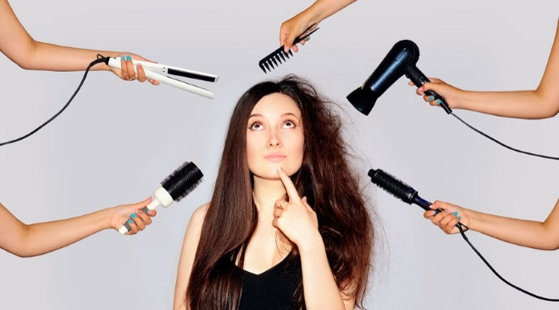
Where do I progress?
Level 3 is an advanced hairdressing programme specialising in colouring, colour correction, cutting techniques and current trends; these will be an extension of your level 2 skills.
You will work in our commercial salon, offering all services. You will be expected to offer excellent customer service and professionalism.

Slide 7
Frequently Asked Questions
How many days a week will I be at college?
Approximately 2 days a week
Will I have to purchase a college kit/uniform?
Approximate price- kit £380/uniform £30- this will be discussed & confirmed at interview
What is college life like?
College is an adult learning environment. We will support you in all aspects of your learning, however as an adult learner we want you take responsibility for your learning. You will have to ensure you are organised and adhere to all assessment deadlines.
Will my attendance and punctuality be monitored?
Yes the Hair & Beauty department instil the highest regards for attendance and punctuality as this is required in the workplace. Your tutor will monitor your attendance weekly.
Can I access extra help at college?
Yes, speak with your tutor at enrolment, induction or throughout any part of your course to gain extra help.

