Slide 1
Industry competitions…
Subtitle

Slide 2
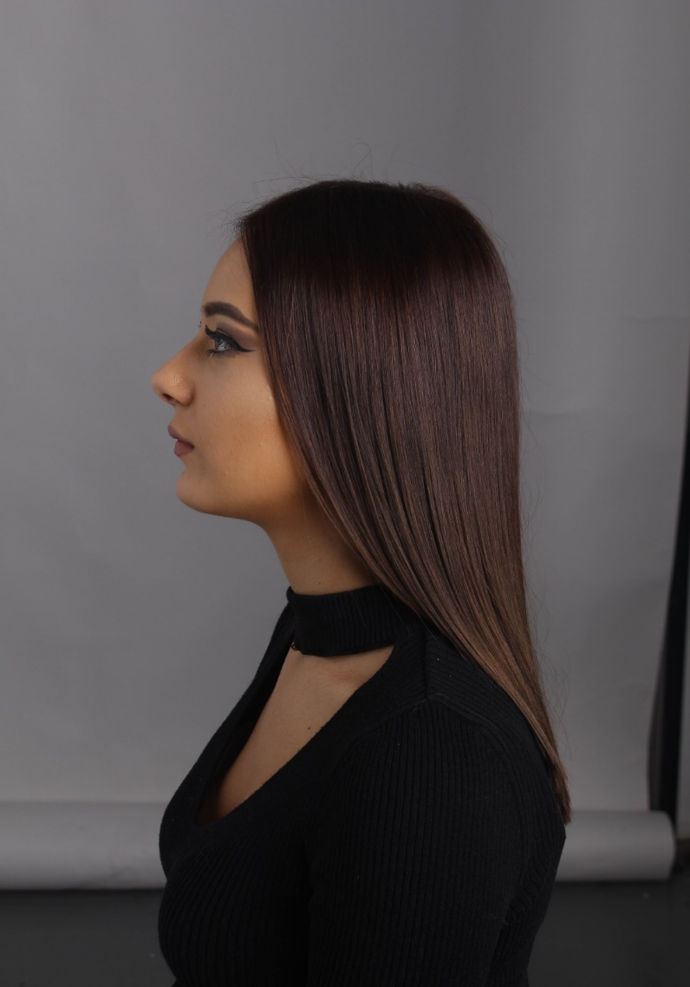
Wella Xposure finalists…

Slide 3
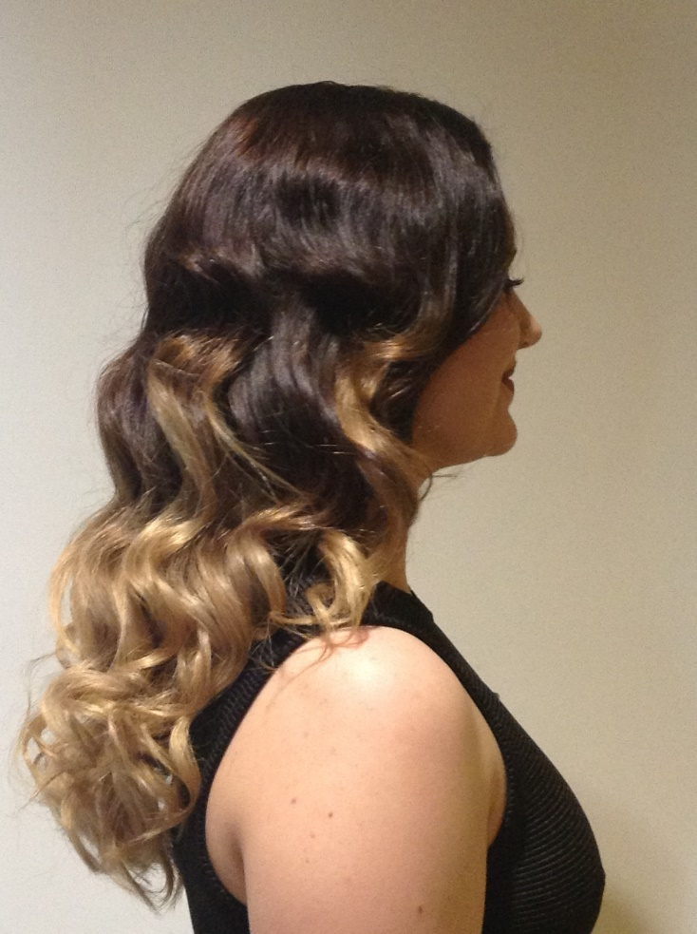

Slide 4
UK finals…. 2019 Silver winner

Slide 5
