Slide 1
Electrical Installation
Level 1 Full Time

Slide 2
Course Summary
A full time 1 year EAL qualification, offering underpinning knowledge and experience across the main areas of the Electrical Industry.
You will undertake both practical and knowledge based training, with one online exam on Health and Safety, all other knowledge assessment is written and marked in-house.

Slide 3
Entry Requirements
You will be required to have attained GCSEs at a grade , 3 (D) or higher in English and Maths, as well as 2 other GCSEs to gain a place on the course.
You will be required to study English and Maths GCSE, in addition to your chosen subject if you have a grade 4 (D) or lower.

Slide 4
Student Experience
  Vocational based learning
  Lecturers with years of real life experience
  Practical and theory sessions
  Dedicated workshop and resources
  Access to library and computers outside of lessons
✓
✓
✓
✓
✓

Slide 5

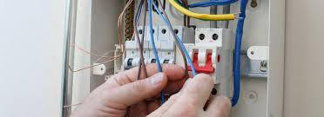
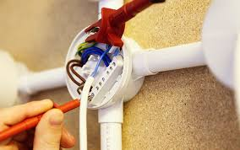
Course Overview
Level 1 - Units of Study
Health & Safety
Environmental protection
Electrical Installation methods
Electrical Installation practical
Electrical Science
Starting work in construction

Slide 6
Tools, Materials & Books
There are some resources that will need to be purchased by yourself, in order to support your journey to become a qualified electrician.
A breakdown of these will be with given to you at interview, as well as predicted costs, A full breakdown is given at enrolment.
Most of these are sourced from local suppliers.

Slide 7

Where Does it Lead?
Progression on to level 2 Diploma, then level 3.
Or
Modern apprenticeship
It is important to remember - in order to become a qualified electrician in the UK, you must have completed a recognised apprenticeship programme.
A shortened version of this can be completed after completing the full-time courses.

Slide 8

For more information contact
Rob_swanson@Weymouth.ac.uk

Slide 9
Course Overview
Level 2
Health & Safety
Electrical Installation theory
Electrical Installation methods
Electrical Installation practical
Electrical Science

Slide 10
Course Overview
Level 3
Environmental legislation
Managing the work environment
Electrical Installation Theory
Electrical Installation practical
Inspection and testing
Fault diagnosis
Electrical Science

