Slide 1

Carpentry & Joinery
- Level 1 Diploma
Presented by Henry Clark

Slide 2
Course Summary
The level 1 Diploma qualification is for candidates who want to work as a Site Carpenter or Bench Joiner in the Construction sector
Entry Requirements
You will need a GCSE grade 4 or C in English and Maths
Occasionally we will accept a 3 or D in one of the subjects
In this is the case, you will be required to study English or Maths GCSE until you have achieved a 4 or C in both subjects.
(Candidates that do not meet the entry requirements will be offered the Construction Skills course with direct progression to level 1 Carpentry & Joinery next year)

Slide 3
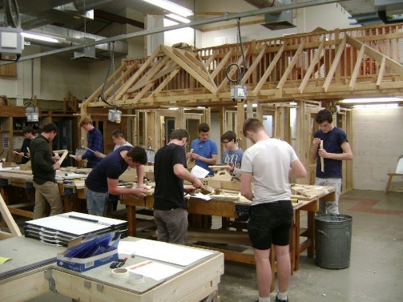
Student Experience
Vocational based learning
A well equipped workshop
Working with your own Basic toolkit
Specialist hand and power tools are supplied
Supported by Carpentry Lecturers with real life experience
Working on practical activities rather than essays
Progressing at your own pace
Access to library and computers

Slide 4


Carpentry & Joinery is NOT……………
Entirely classroom based!
Boring
Only about numbers and boring subjects

Slide 5
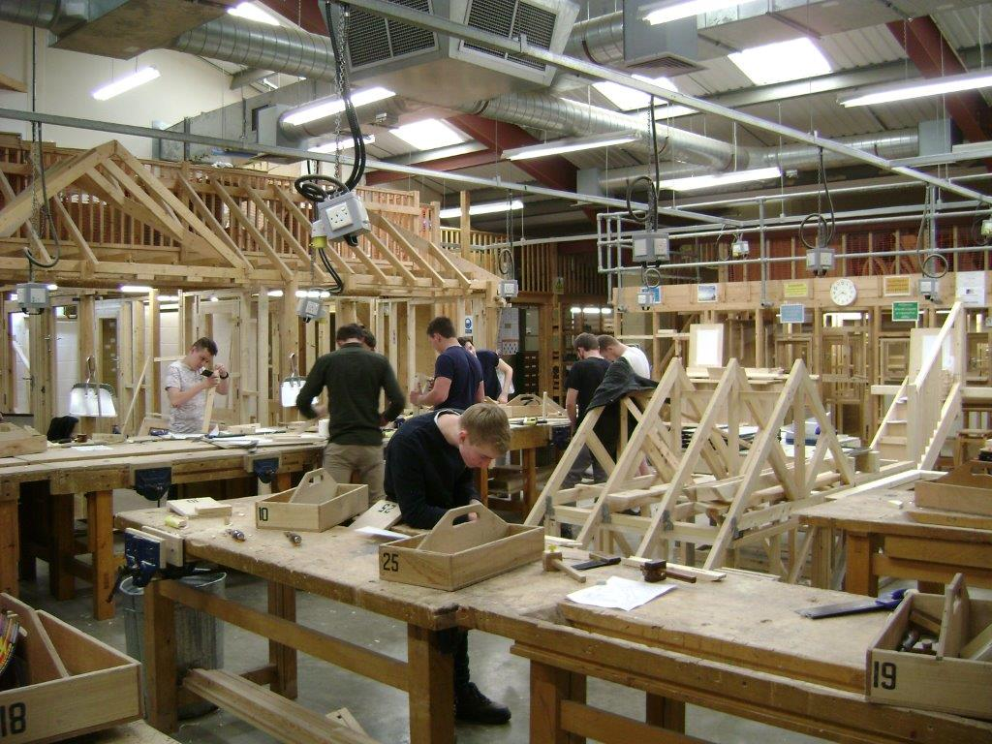

Carpentry is DEFINITELY…
Active learning
Assessment by activity
Interesting and varied
FUN!!!

Slide 6
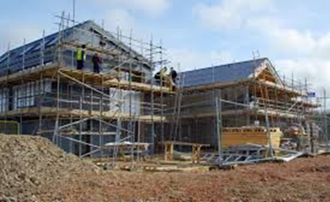
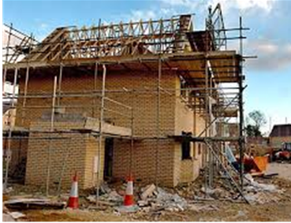
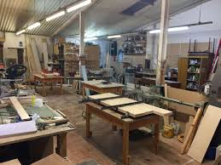
Working towards a career in construction

Slide 7
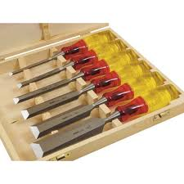

Course Overview
YEAR 1
Principles of building construction, information and communication
Maintain and use Carpentry & Joinery hand tools
Prepare and use Carpentry & Joinery power tools
Produce woodworking joints
Health Safety and Welfare in construction

Slide 8

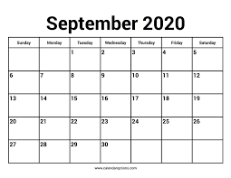
Attendance
Full Time 2.5 Days per week
  Monday to Wednesday lunchtime
Part Time 1 Day per week
  Tuesday all day
  Infilling with the apprentice group
  09:00 to 12:30am 13:30 to 16:45

Slide 9
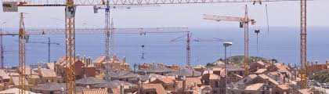

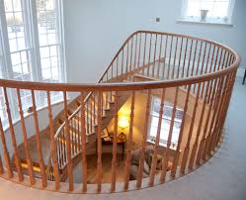

Where Does it Lead?
The only limit is your imagination

Slide 10


For more information contact
Henry_Clark@Weymouth.ac.uk

