Slide 1

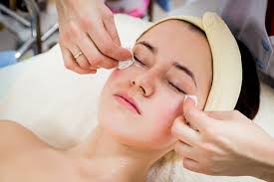
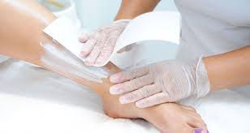
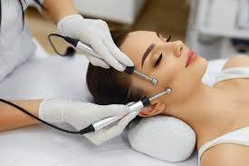
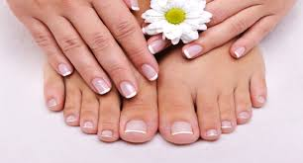
BEAUTY THERAPY
LEVELS 1, 2 AND 3

Slide 2
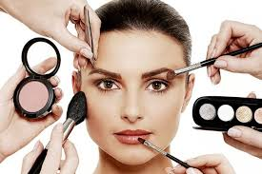
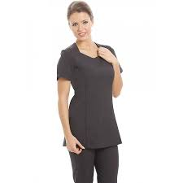
VTCT LEVEL 1
CERTIFICATE IN BEAUTY THERAPY
SELECTION By interview minimum entry requirements 3 GCSE’s at Level 3 or equivalent including English and Science.
ASSESSMENT Appraisal of practical ability in Facial, Manicure, Pedicure and Make-up treatments, Assignments, Portfolio work, Industry related research and Career progression.
COURSE CONTENT
This qualification introduces you to practical Beauty Therapy skills. It provides you with the foundation for further learning and progression pathways within the Beauty Therapy framework or other chosen pathway.
PROGRESSION
Natural progression route would be onto Level 2 Beauty Therapy. This is only possible if you have maintained a high level of attendance, punctuality and shown commitment to your course. You will also be required to carry out a practical and written test.
ADDITIONAL QUALIFICATIONS
If you have not achieved your GCSE Maths and English then you will be expected to work towards these or Functional Skills alongside your main qualification.

Slide 3
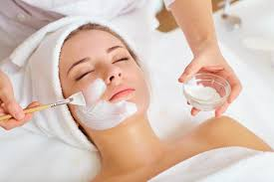
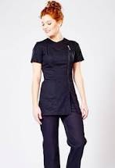
CITY AND GUILDS LEVEL 2 DIPLOMA IN BEAUTY THERAPY
PROGRESSION
It is recommended that you progress onto Level 3 to advance your skills and widen career opportunities.
SELECTION
By interview minimum requirements of grade 4 or equivalent including English, Maths and Science.
ASSESSMENT
Appraisal of practical competence,
Oral assessments, Written/online tests
Portfolio work
Assignments
COURSE CONTENT
Health and Safety
Working in Beauty related Industry
Client care and Communication
Reception
Promote Services and Products
Facial Skin Care
Waxing
Manicure and Pedicure
Eyelash and Brow treatments
Make-up

Slide 4
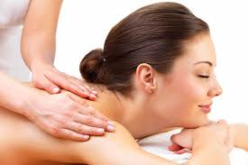
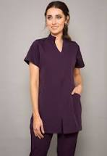
CITY AND GUILDS LEVEL 3 DIPLOMA IN BEAUTY THERAPY
ENTRY REQUIREMENTS
After completing Level 2 you will now be prepared for the high standards required to work in this industry
COURSE CONTENT
Monitor procedures to safely control work operations
Contribute to the planning and Implementation of promotional activities
Provide Electrical Epilation
Provide Body Massage
Provide Body Electrical treatments
Provide Facial Electrical treatments
Carry out Massage Using Pre-blended Aromatherapy oils
Provide Tanning Services
SELECTION
You must have completed Level 2 Beauty Therapy and selection is based on your commitment shown throughout your Level 2 qualification. You will have an interview with your Tutor, be expected to successfully complete a trade test and pass a theory test reaching a minimum of a merit grade. We expect our learners to maintain the high standards set out in Level 2 and continue with their personal development. As part of your course you will be expected to carry out five external work experience days which must be Industry based.
ASSESSMENT
Appraisal of practical competence
Oral assessment
Online/ written tests
Portfolio work
Assignments
Work experience
PROGRESSION
Into Industry, Beauty Management courses, Further Education or Higher Education

Slide 5
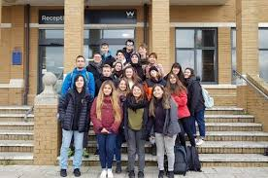
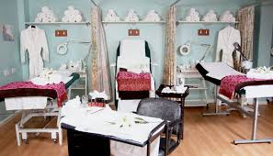
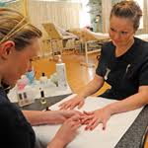
Frequently Asked Questions
How do I apply for a course?
Go onto the College Website and apply on line.
What if I am not sure what course I want to do?
You can have multiple interviews with staff from different areas to discuss your options.
How many days a week will I be at college?
Approximately 3 days a week in college and one independent study day.
Will I have to purchase a kit and uniform?
Yes, this is approximately £?? and will be discussed at enrolment.
Will I have the opportunity to resit my GCSEs?
Yes, unless you already have English and Maths at Grade 4, GCSE retakes will be built into your timetable.
What is college life like?
College is an adult learning environment. We will support you in all aspects of your learning, however as an adult learner we want you take responsibility for your learning. You will have to ensure you are organised and adhere to all assessment deadlines.
Will my attendance and punctuality be monitored?
Yes the beauty department instil the highest regards for attendance and punctuality as this is required in the workplace. Your tutor will monitor your attendance weekly.
Can I access extra help at college?
Yes, speak with your tutor at enrolment, induction or throughout any part of your course to gain extra help.

Slide 6

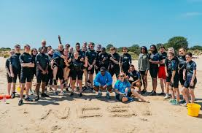


National Citizens Service (NCS)
All learners on a level 2 qualification will take part in NCS.
This involves a residential stay with your group and team building activities.
You will then put your skills and experience into a community project chosen by your group where you can see the impact of your work on the local community.

Slide 7
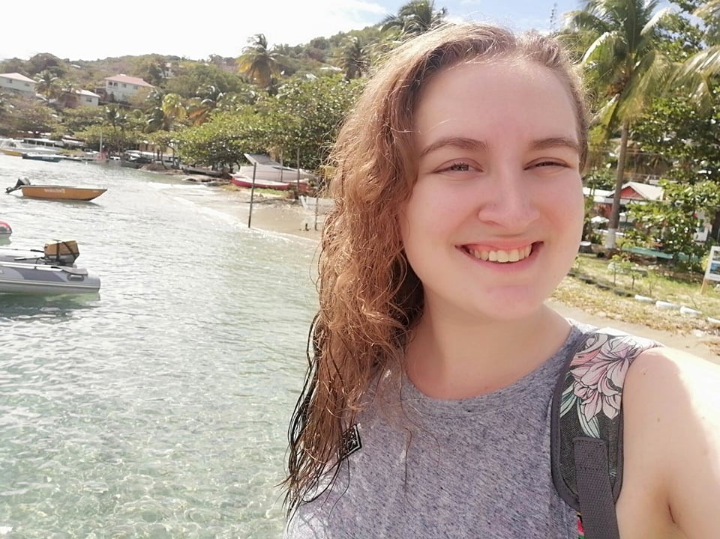
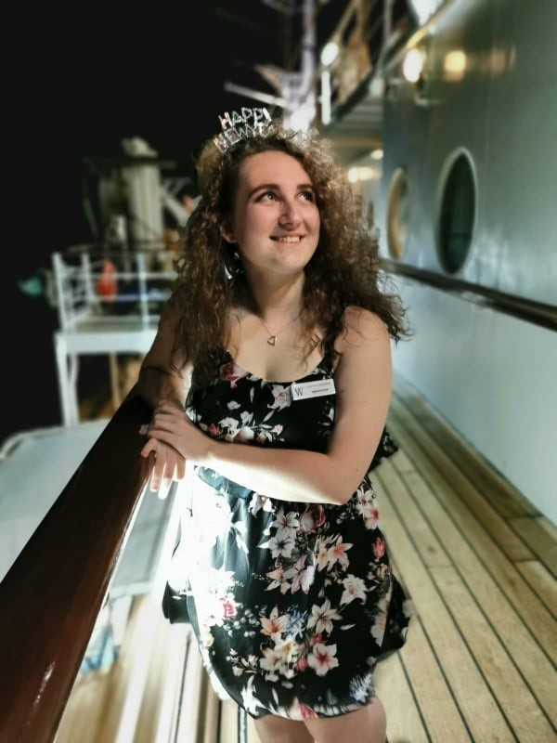
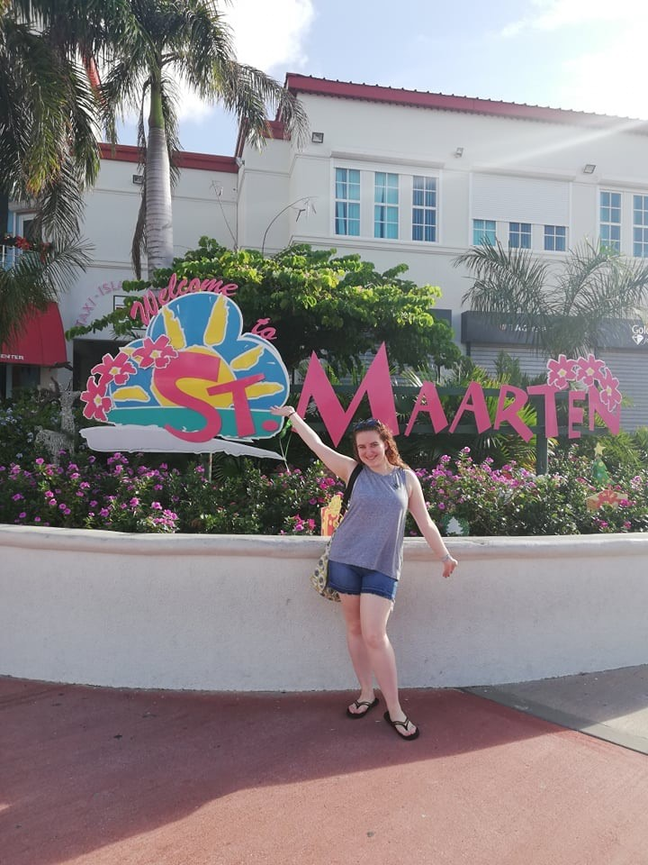

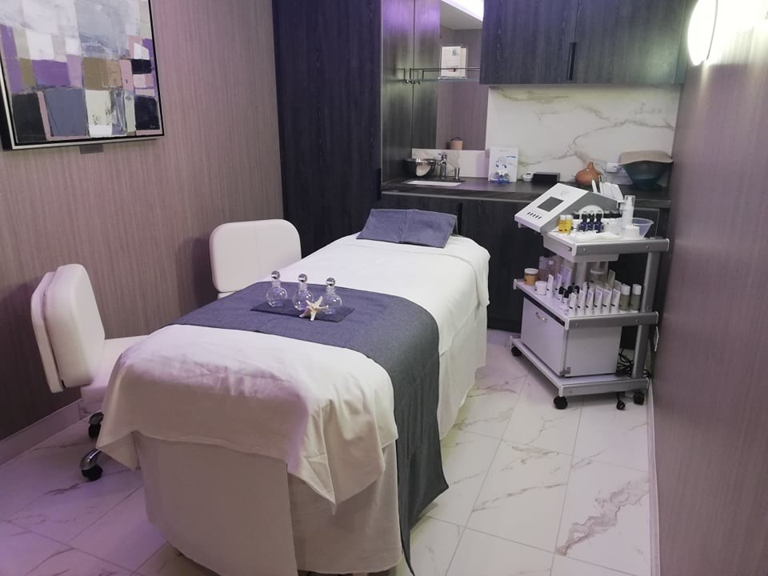

WE ARE EXTREMELY PROUD OF ALL OUR STUDENTS ACHIEVEMENTS THIS IS JUST ONE STORY.
This is the Wind Surf part or the Wind Star Brand of Luxury Yachts. Former Weymouth College Beauty Student Lauryn Haskins is working as a Beauty Therapist on this Yacht.

