Slide 1

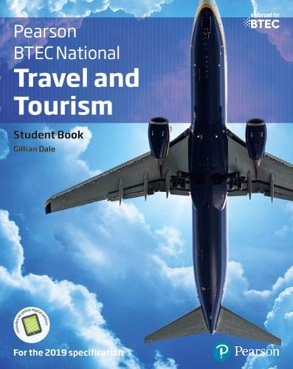
BTEC National Level 3
Extended Diploma in
Travel and Tourism
Course Leader and Tutor Tonia Fisher

Slide 2

Course Summary
This two year course is a nationally recognised qualification that combines theoretical, practical and work-related activities.
Qualification is made up of thirteen units.
Assessment for the course is by course work and external exams for 2 units; assignments are based on realistic workplace situations, activities and demands
Entry Requirements are 5 GCSEs at grade 4 or C to include English and Maths or a minimum merit grade in C&G First Diploma in T&T .
You will develop a range of skills, knowledge, personal qualities and attitudes essential for a career in travel & tourism related employment.
You will benefit from being taught by a well-qualified team of lecturers with substantial teaching and practical experience

Slide 3

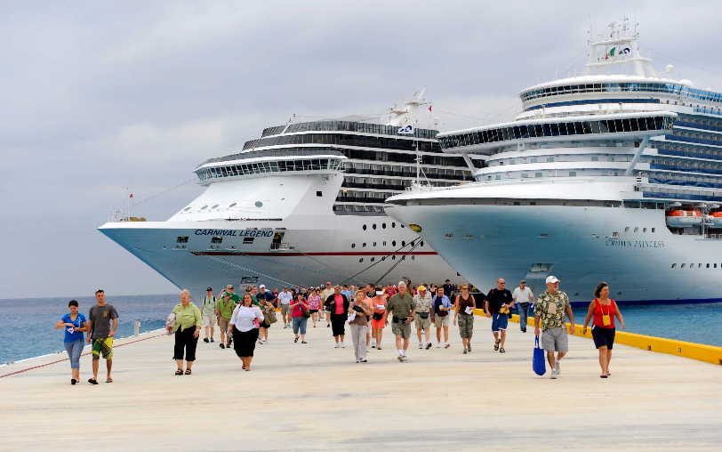
Programme of study
Year 1
The World of Travel and Tourism
Global Destinations
Principles of Marketing in Travel & Tourism
Managing the Customer Experience in Travel & Tourism
Visitor Attractions
The Cruise Industry
Year 2
Researching Current Travel Trends and Key Issues in T&T
Travel and Tourism Enterprises
Working Overseas
Work Experience in T&T
Recruitment and Selection in T&T
Managing Accommodation Services
The UK as a Destination

Slide 4
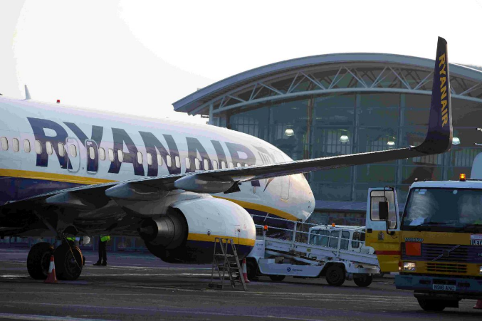
Industry Experience
Experience the workplace is important for any course. During the Level 3 course, we will include a variety of industry based activities to allow you to review your options for career paths or employments.
Industry based activities include;
  Two week work experience in industry.
  Variety of industry speakers ranging from airlines, travel agents, air traffic control, event organisers, visitor attractions and accommodation providers
  Local and international day trips and residential visits
  Practical role plays in a simulated environment

Slide 5
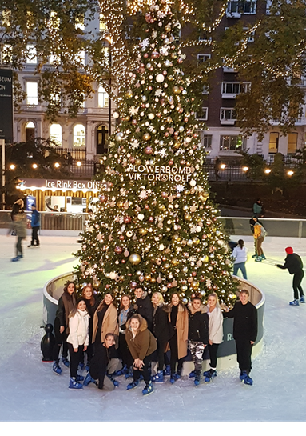
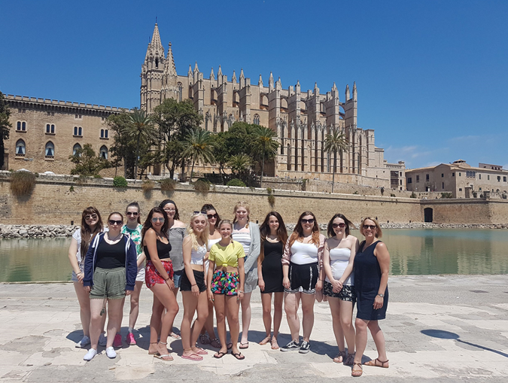
Activities & Trips
Overseas residential
Warner Brothers Studio Tour - London
World Travel Market, Excel, London
Bournemouth Airport
Sealife Centre
Longleat Safari Park
Various accommodations
IMPORTANT: All trips & activities will be subject to student financial contribution & availability

Slide 6
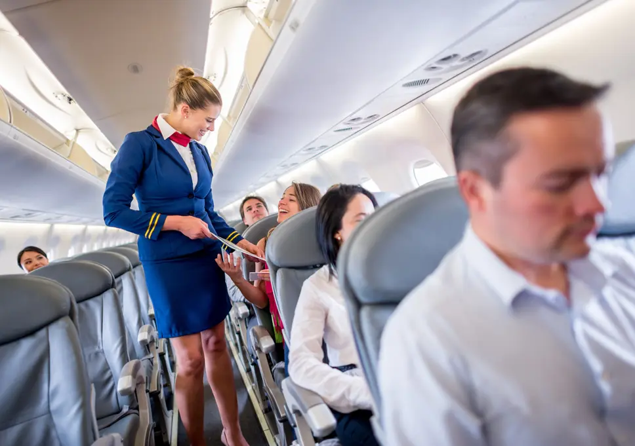
Additional Activities/ Qualifications
NCFE Level 2 Introduction to Cabin Crew
First Aid certificate
GCSE Mathematics & English retakes
Functional Skills Qualifications

Slide 7




Where do I progress?
Student Destinations:
Higher Education
Employment
Travelling/gap year

Slide 8

Higher education choices:
Learners can progress to degree courses such as:
• BA (Hons) in Hospitality, Leisure, Sport and Tourism (includes Travel Management);
Event Management; Tourism Management; Transport Studies; Air, Land and Sea travel;
Hospitality Management; Recreation and Leisure Studies; Spa, Salon or Sport Management
• BA (Hons) in Business Studies
• BA (Hons) in Business Management with Accounting and Finance
• BA (Hons) in Marketing
• BA (Hons) in International Tourism Management
• BA(Hons) in Geography and Tourism
• Bsc (Hons) in Geography and Environmental Management.

Slide 9
Frequently Asked Questions
How many days a week will I be at college?
  Approximately 4 days a week in college and one independent study day.
Will I have to pay for trips and visits?
  Yes, this will be discussed at enrolment. Student financial support available depending on family income.
Will I have the opportunity to resit my GCSEs?
  Yes, unless you already have English and Maths at Grade 4, GCSE retakes will be built into your timetable.
What is college life like?
  College is an adult learning environment. We will support you in all aspects of your learning, however as an adult learner we want you take responsibility for your learning. You will have to ensure you are organised and adhere to all assessment deadlines.
Will my attendance and punctuality be monitored?
  Yes the T&T department instil the highest regards for attendance and punctuality as this is required in the workplace. Your tutor will monitor your attendance weekly.
Can I access extra help at college?
  Yes, speak with your tutor at enrolment, induction or throughout any part of your course to gain extra help.

Slide 10


For more information contact
Tonia_fisher@weymouth.ac.uk

